Slide 1

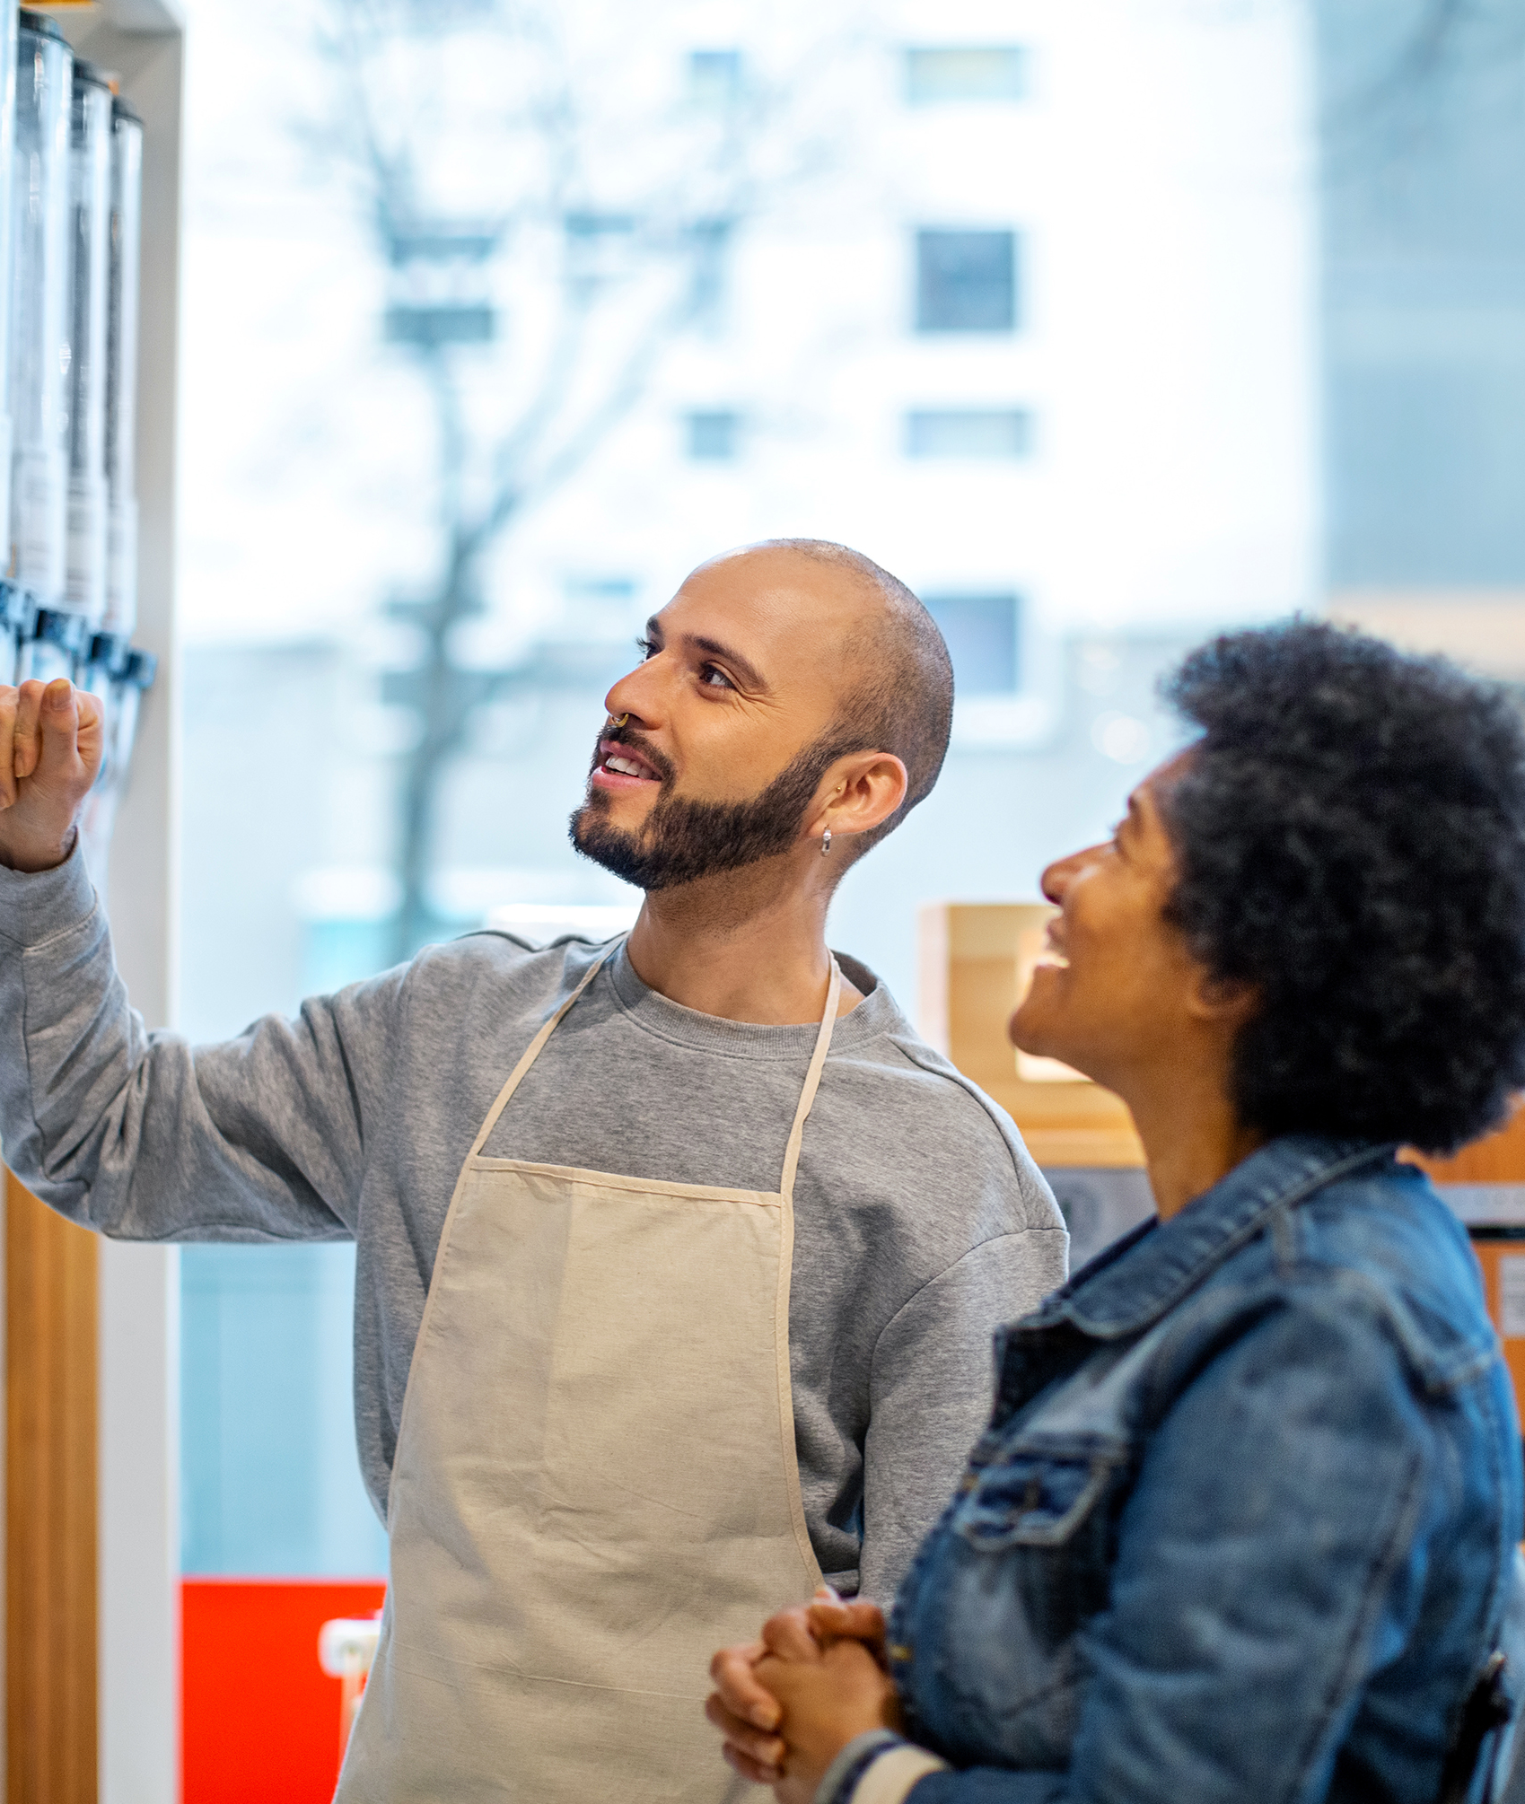
MODULE 1
I want to start a business
www.mosaic4investing.eu

Slide 2
Introduction
01
Discovering Personal Motivation and Entrepreneurial Mindset
Module 1 is designed to equip aspiring underrepresented entrepreneurs with the fundamental knowledge and skills needed to begin their entrepreneurial adventure.
Importantly, we aim to address your unique challenges and provide the tools necessary for success.
02
Identifying and Leveraging Personal Talents for Business Success
03
What Challenges do Underrepresented Entrepreneurs Face when Starting a Business?
04
Understanding Different Business Models
05
Positioning is Key
Self-Reflection and References

Slide 3
Learning Outcomes
Knowledge:
Personal and External Factors:
Build a foundation of self-awareness and understanding of the entrepreneurial ecosystem that is crucial for underrepresented founders at the outset of their business endeavours.
Prepare learners for the entrepreneurial journey by focusing on personal motivation and basic understanding, setting the stage for more detailed planning and execution in later modules.
Understand the Entrepreneurial Landscape:
Learn about the specific challenges and opportunities that underrepresented founders face when starting a business.

Slide 4
Learning Outcomes
Skills:
Develop the ability to assess one’s own motivations and the initial feasibility of entering entrepreneurship. This includes understanding personal strengths, weaknesses, and the potential for growth.
Behaviours:
Openness to Learning: Encourage behaviours geared towards openness and eagerness to learn about entrepreneurship, particularly the nuances that affect underrepresented groups.
Initiative: Understand the behaviour of taking the initiative as a foundational requirement of starting a business.

Slide 5
Learning Outcomes
Attitudes:
Embrace Entrepreneurial Challenges: Promote an attitude of resilience and readiness to tackle the unique challenges that come with starting a business.
Valuing Diverse Perspectives: Foster a mindset that appreciates and promotes diverse perspectives, which is critical for underrepresented founders to leverage their unique backgrounds.

Slide 6
01
Discovering Personal Motivation and Entrepreneurial Mindset

Slide 7

What is Personal Motivation?
Personal motivation is the internal drive that prompts an individual to act towards a goal. It is the internal spark that ignites you to take action. It’s a relentless drive that wakes you up in the morning, eager to push forward your vision. In the context of founding a business, it is a potent mix of:
Values: Your business acts as a reflection of your core principles. Think of your values as your compass, guiding every decision and operation. They ensure your business mirrors your personal ethics, whether it's sustainability, fairness, or innovation. These are non-negotiable and define how you do business.

Slide 8

What is Personal Motivation?
Desires: Imagine shaping a business that not only meets your needs for financial independence but also fulfils your deepest wish to make a meaningful impact. As an underrepresented founder, whether it’s revolutionising an industry, transforming your community, or providing innovative solutions, these desires fuel your entrepreneurial spirit.
Goals: Goals keep us focused and moving forward.
Are you good at turning the abstract into reality?

Slide 9
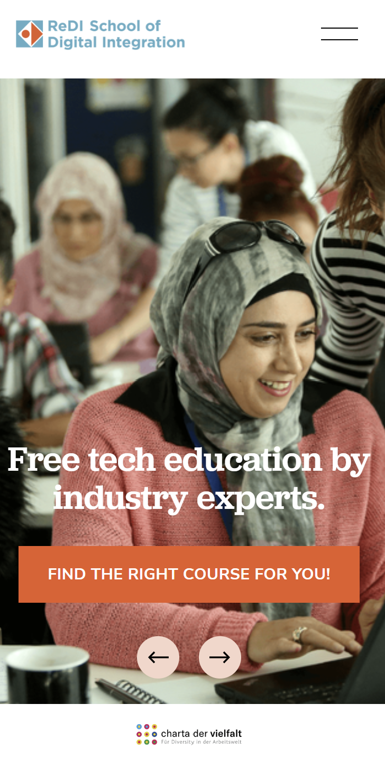
Personal Motivation in Action
It’s useful to consider the personal motivation of Anne Kjaer Riechert, co-founder of ReDI School of Digital Integration. Based in Germany, Anne co-founded ReDI School in 2015 to address the challenges faced by refugees and immigrants seeking integration into the European digital job market.
Motivation: Anne's motivation stemmed from her firsthand observations of the challenges faced by migrants and locals with challenges circumstances in accessing quality education and meaningful employment in the tech industry. She was also motivated to address the skills gap in the European tech industry.
Goal: Her goals are to equip students with crucial digital skills, fostering a growth mindset and enhancing career skills through practical, high-quality educational offerings.
Michele Ruiz

Slide 10
Personal Motivation in Action
Values: Anne’s approach to ReDI School is deeply rooted in values of equality, inclusivity, and community. She believes that technology can be a great equaliser, and through ReDI School, she aims to ensure that nobody is left behind in digital transformation. Her commitment to these values drives the school’s community-oriented approach.
Impact: Under Anne’s leadership, ReDI School has:
Expanded Learning Opportunities: Provided hundreds of migrants and marginalised locals with free access to high-quality digital education, from coding classes to basic computer skills.
Fostered Industry Connections: Established partnerships with leading tech companies and startups, facilitating mentorship opportunities and direct career pathways for students.
Built a Supportive Community: Created a vibrant community where students, teachers, and tech professionals come together to support one another, share knowledge, and build networks that transcend cultural and economic barriers.
Michele Ruiz

Slide 11
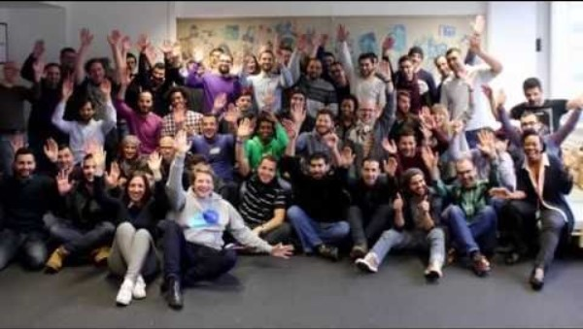
Personal Motivation in Action
Anne’s work has been widely recognised …
Edition F as one of "25 Women" revolutionising German industry
Handelsblatt as "Mutmacher of the Year“ in 2018
Best Female Social Entrepreneur of the Year in Germany 2020,
Ashoka Fellow in 2021
One of Germany’s top 50 female founders by Handelsblatt 2022
German CIO of the Year “Digital Future” 2023.
WATCH Press play
READ MORE
https://www.redi-school.org/
https://www.redi-school.org/s/Presse_Vita_AnneKjaerBathel_e_06_2024_finaldocx.pdf
Michele Ruiz

Slide 12
Reflect – What is your Personal Motivation?
To help you identify and understand your personal motivations for founding a business, let’s clarify your driving forces.
STEP ONE: Begin by writing down your initial thoughts about why you want to start a business. These 7 questions are a great start…..
What comes to mind first when you think about your motivations?
What are your personal goals for the next five years, and how does entrepreneurship fit into these goals?
What are you most passionate about, and how can your business help you engage more deeply with this passion?
What inspired you to consider entrepreneurship? Reflect on any moments of inspiration or necessity that pushed you towards this decision.

Slide 13
Reflect – What is your Personal Motivation?
5. What values are most important to you in your work? For example, independence, innovation, financial success, creativity, or helping others, .
What impact do you hope to have through your business? Think about the broader effects on your community, industry, or even globally.
When you face challenges, what keeps you going? Consider the internal or external sources of strength that you can tap into during tough times.
STEP TWO: Visualisation
Close your eyes and imagine a day in your life, five years from now, having pursued your dream of founding a business. What does it look like? How do you feel about the work you are doing? Visualize the outcomes of your efforts.

Slide 14
Reflect – What is your Personal Motivation?
STEP THREE: Reflection on Responses:
Review your answers and look for recurring themes or ideas that stand out.
Are there consistent values or goals that appear in your responses? These highlights can reveal the core motivations that drive your entrepreneurial spirit.
STEP FOUR: Summarise Your Motivation:
Based on this exercise, summarise in a few sentences your core personal motivations for pursuing entrepreneurship. This summary can serve as your motivational statement.

Slide 15

Examples of Personal Motivations
My drive stems from a personal journey of overcoming health challenges through natural remedies, which transformed my quality of life. This personal experience gave me a profound appreciation for holistic health approaches and a passion for making these solutions accessible to others.
My background is food science, and I have studied natural medicine for 3 years. My goal is to create a profitable health supplement brand and business that is recognised for its integrity, quality, and commitment to customer well-being.
In the next five years, I envision my brand becoming a respected player in the health supplement market. I will lead a business with a suite of innovative, science-backed products while continuously overcoming personal and industry challenges
1
2
3

Slide 16
What is an Entrepreneurial Mindset?
An entrepreneurial mindset is not only about starting a business, not a way of thinking that enables people to overcome challenges, leverage opportunities, and drive innovation. Let’s look at the key mindset characteristics:
Resilience: The capacity to recover quickly from difficulties; toughness. | Context for Underrepresented Founders: Resilience is about bouncing back from setbacks. For founders from underrepresented backgrounds, it involves transforming challenges into catalysts for growth and innovation. It means persisting through systemic barriers, disproving doubters, and often, paving a new path where one did not previously exist.

Slide 17
What is an Entrepreneurial Mindset?
Adaptability: The ability to adjust to new or changing circumstances rapidly and efficiently. | Context for Underrepresented Founders: In a business world where change is the only constant, adaptability is a necessity. This trait is especially pivotal for underrepresented founders, who often navigate more complex landscapes due to cultural, systemic, or economic barriers and whose background and experiences provide them with unique insights into markets and needs that may be invisible to others.
Initiative: The ability to assess and initiate things independently. | Context for Underrepresented Founders: Taking initiative is foundational in entrepreneurship. It's about proactive problem-solving and pre-emptive action. For those in underrepresented groups, taking initiative can also mean starting resource networks, and actively seeking new partnerships.

Slide 18
What is an Entrepreneurial Mindset?
Innovation: a dynamic process of implementing novel ideas that add value in diverse ways. Innovation encompasses technology, design thinking, and strategic foresight to develop solutions that are sustainable and scalable | Context for Underrepresented Founders: Innovation is the heart of entrepreneurship. It involves creating new products or services by innovating the ways we think about and address social or cultural challenges. For underrepresented founders, innovation is about leveraging their unique life experiences and insights to craft solutions that meet the needs of a broader audience.
"Innovation starts with seeing the potential in the ordinary. It's about looking at everyday problems and dreaming up simple solutions that can make a big impact." - Jane ní Dhulchaointigh, the Irish inventor of Sugru,

Slide 19
02
Identifying and Leveraging Personal Talents for Business Success

Slide 20

Personal Talents
Personal talents are those innate unique skills, strengths, and attributes that everyone possesses and can bring to an enterprise venture. Talents span both innate abilities and developed competencies. They are the areas where you exhibit a natural inclination or proficiency without extensive learning or effort. They can be thought of as the intersection of your passions, skills, and inherent abilities.
Understanding and leveraging your personal talents can give you a significant advantage in the competitive business landscape. It allows you to build a business that resonates with your personal identity and values.

Slide 21
Personal Talents
Talents manifest as an ease and enjoyment in performing certain activities, leading to higher proficiency and satisfaction. Some ideas…
Innate Ability: Talents are often ingrained, something you are "born with" or have developed early in life intuitively. What are your innate abilities?
Ease of Performance: Activities that align with your talents can usually be performed with a natural ease compared to tasks that do not align with your talents. What activities do find easy to do?
Rapid Learning: When engaging in activities related to your talents, you may find that you learn and master skills much faster. What are these for you?
Joy and Energy: Engaging in your talents typically brings enjoyment and may energize you, in contrast to tasks that feel draining or overly challenging. What gives you joy and energy?

Slide 22
Examples of Personal Talents
Interpersonal Communication: Some individuals have a natural talent for communicating and connecting with others, making them effective in customer-facing businesses.
Analytical Thinking: This talent includes the ability to break down complex problems and identify patterns, which is crucial in business starts in finance, research, and technology.
Physical Talents, e.g. athleticism: Natural physical abilities that can lead to start-ups in sports, fitness training, or dance.
Creative Innovation: Those with a talent for creativity excel in generating new ideas, designing products and creative outputs
Culinary talents: That love and flair for cooking

Slide 23

Examples of Personal Talents Inspiring Business Startups
Anna Nooshin: From refugee to entrepreneur. My specialness
Anna Nooshin is an online entrepreneur, fashion blogger, and author. The entrepreneur who fled her hometown of Teheran in 1993 to reach The Netherlands, established the webzine NSMBL, one of the biggest lifestyle websites in the Netherlands; and since its incredible success, she has launched her own lingerie line, published her own book, and started a jewellery line, Anna + Nina. Anna has an inspirational story to tell.
Click play on picture or visit

Slide 24

Examples of Personal Talents Inspiring Business Startups
The journey of Irish based Funké Egberongbe, from refugee to restaurant owner, characterises the power of personal talents combining with dreams and determination. Originally from Nigeria, Funké arrived in Ireland 19 years ago as an asylum seeker.
Pregnant and alone, she navigated the unfamiliar environment, enduring the hardship of moving between various refugee accommodations. It was during this challenging time that she discovered her passion for cooking, as she started preparing meals to improve the quality of food available in the refugee centres.
li

Slide 25

Examples of Personal Talents Inspiring Business Startups
Funké spent seven years in the asylum process before her family could join her in Ireland. In this time, she honed her cooking skills and pursued education when the opportunity arose. Upon receiving her residency, Funké attended the College of Further Education. Later, she earned a degree in food science. COVID-19 lockdown became a turning point for Funké. With more time at home, she began cooking extensively, sharing her creations on Instagram https://www.instagram.com/funkeskitchen_/.
Her online presence quickly grew, leading to the opening of Funké Afro Caribbean Restaurant in October 2023. Her restaurant offers a variety of African and Caribbean dishes, tailored to local tastes, and she has now launched a range of award-winning sauces.

Slide 26

Examples of Personal Talents Inspiring Business Startups
TransTech Social is a co-learning and co-working community created to empower, educate, and employ the LGBTQ+ community through accessible education programmes, inclusive events, and equitable employment opportunities that teach practical career-ready skills.
US based TransTech Social was founded in 2014 by Angelica Ross. After teaching herself graphic design, photo editing, and coding – she realised that technology was a catalyst for change in her life! She used her skills to create a foundation for financial security, then reached out to the community around her to share those skills.
https://transtechsocial.org/

Slide 27
Reflect – your talent inventory
Talent Category | Talent Examples | Now reflect and write specific personal instances where these talents have been demonstrated:
Technical Talents | Technical (e.g. .talents, coding, graphic design), Project management | List examples where you have used these skills effectively.
Interpersonal Talents | Empathetic communication, persuasive selling, team collaboration. | Describe situations where these strengths were evident
Character Talents | Resilience under pressure, integrity in decision-making, proactive leadership. | Reflect on how these attributes have influenced your interactions or decisions.
Consider how these talents can be applied or need to be developed in your future entrepreneurial plans.

Slide 28
03
What challenges do underrepresented entrepreneurs face when starting a business?

Slide 29

“These founders are not just underrepresented—they are underestimated”.
McKinsey

Slide 30
Influential Article
McKinsey Article: Underrepresented start-up founders | McKinsey
“All founders experience roadblocks when creating new, innovative businesses. Underrepresented founders, however, experience greater hurdles. These challenges tend to fall into four “Big Rock” categories that compound over time and lead to the representation gap in the overall founder population.
Big Rock #1: Systemic limited access to start-up network, community support, and resources
Big Rock #2: The need to overcome biases related to founder perception
Big Rock #3: Limited established blueprint for success
Big Rock #4: A greater need for mental health resilience

Slide 31

Big Rock #1 Systemic Limited Access
Many underrepresented founders are challenged with systemic limitations or barriers. These barriers are not always overtly discriminatory but can arise from long-standing practices and biases that privilege certain groups over others, making it difficult for underrepresented founders to gain a foothold.
They are particularly pronounced in
challenges in securing funding
finding mentors, community support and resources.
accessing crucial startup and established business networks, often due to a lack of visibility and systemic biases within these structures.

Slide 32
Big Rock #1 Systemic Limited Access
Challenges in Securing Funding
Access to capital is a fundamental need for all new businesses, yet underrepresented founders often face higher hurdles in securing investment.
Research is clear; businesses led by individuals from underrepresented backgrounds receive a significantly smaller % of venture capital funding compared to their counterparts.
The reasons for this disparity include a lack of representation within venture capital firms, unconscious biases affecting decision-making, and a smaller likelihood of having connections with potential investors.
Our training programme has content that will really help. Check out INSERT PIC OF
Module 4: How Do I Secure Funding for My Idea?
Module 7 Show me the money! How to convince investors to back an idea

Slide 33
Big Rock #2 Biases Related to Founder Perception
A bias refers to an inclination or prejudice for or against one person or group, especially in a way considered to be unfair. Did you know there are two types of bias?
Conscious (Explicit) Bias:
These are prejudices that an individual is aware of and are based on conscious thoughts. People who have explicit biases are aware of their prejudices and attitudes toward certain groups.
2. Unconscious (Implicit) Bias:
Unconscious biases are social stereotypes about certain groups of people that individuals form outside of their conscious awareness. Everyone holds unconscious beliefs about various social and identity groups, and these biases stem from one’s tendency to organize social worlds by categorizing.

Slide 34

Big Rock #2 Biases Related to Founder Perception
It is useful to stand back and reflect on Common Sources of Biases
Cultural Background: The culture in which individuals grow up can influence their views and attitudes toward other groups. Cultural narratives and media portrayals often shape these unconscious attitudes.
Personal Experiences: Individual experiences, including the type of interactions one has with members of different groups, can reinforce or challenge biases. Positive or negative experiences can significantly impact one’s unconscious perceptions.

Slide 35

Big Rock #2 Biases Related to Founder Perception
Education and Socialisation: Education or lack thereof about diverse cultures, races, and social groups can influence the development of biases.
Human Brain’s Tendency to Categorise: The human brain automatically categorises information to simplify the complex world around it. This cognitive shortcut can lead to generalised assumptions about groups of people based on limited experiences or teachings.

Slide 36
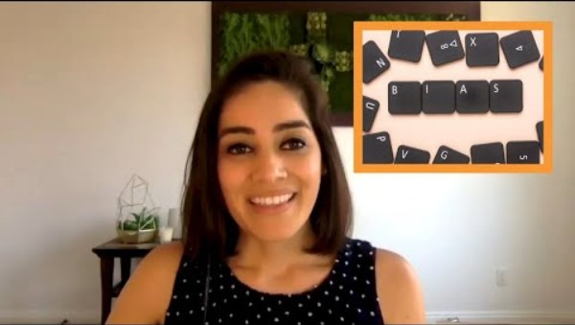
WATCH
How Investor Bias Towards Underrepresented Founders Manifests Itself | Lolita Taub
A short and fascinating interview with Lolita Taub gives insights. Lolita set up Ganas Ventures, which invests in early-stage community-driven startups in the US and Latin America. 100% Latina-owned and led by @lolitataub
.

Slide 37

Big Rock #3 Limited established blueprint for success
Navigating Without a Map: Addressing the Blueprint Gap
Underrepresented founders often find themselves in uncharted territory, with few precedents or role models who share their background or experiences. This lack of a 'blueprint' or established path to success can make the journey more daunting and complex.
Throughout our course, we have been careful to include case studies and personal experiences.
Check out Module 6 also- Networking for Underrepresented Founders.

Slide 38
Big Rock #4 Greater need for mental health resilience
The mental toll of entrepreneurship is well-documented, but for those from underrepresented groups, these challenges are intensified by experiences of discrimination, lack of support, and sometimes the pressure of representing their entire community. Underrepresented founders often face a compounded set of stressors that can impact their mental health more significantly than their counterparts:
Feeling isolated, without a support network that understands their unique challenges, can lead to a sense of loneliness and decreased mental resilience.
Burnout: Prolonged exposure to stress without adequate support can result in burnout, which significantly impacts an entrepreneur's ability to continue running their business effectively.

Slide 39
Big Rock #4 Greater need for mental health resilience
Some Tips
Cultivate a deep understanding of your own mental health needs. Recognize the signs of stress, anxiety, and burnout early, and educate yourself on mental health to better manage symptoms before they escalate.
Incorporate regular wellness practices into your daily routine to help manage stress and maintain mental health. This might include regular physical activity, mindfulness exercises, rest, and balanced nutrition
If you can, set clear boundaries between work and personal life to prevent burnout.
Make use of digital tools and apps designed to support mental health, such as meditation apps, mood trackers, or online therapy platforms. These tools can provide accessible ways to manage stress and maintain mental wellness.

Slide 40
Let’s Recap, What do we know so far?
Entrepreneurship often starts from a profound self-awareness of one's aspirations and resilience.
Successful entrepreneurs effectively utilise their unique skills to carve out niches where they can address market needs and excel. This alignment of personal strengths and business opportunities is crucial for achieving meaningful and sustainable success.
Underrepresented entrepreneurs encounter unique challenges that go beyond common entrepreneurial hurdles. These include overcoming pervasive biases and systemic barriers that restrict access to essential resources and networks. Such challenges require navigating a more intricate landscape, often without established pathways to follow, presenting both significant obstacles and opportunities for demonstrating resilience and innovative problem-solving.

Slide 41
04
Understanding Different Business Models

Slide 42
Understanding different business models
Starting a business requires a clear vision not only of what you want to achieve but also of how you plan to achieve it. This is where understanding different business models comes into play.
A business model isn’t about how a company makes money—it’s about the entire system of how value is created and delivered to customers and how revenue is generated from those operations.
Understanding different business models is a crucial aspect of what starting a business entails. Choosing the right business model is pivotal, as it directly influences your operational decisions, growth strategy, and, ultimately, the success of your venture.

Slide 43
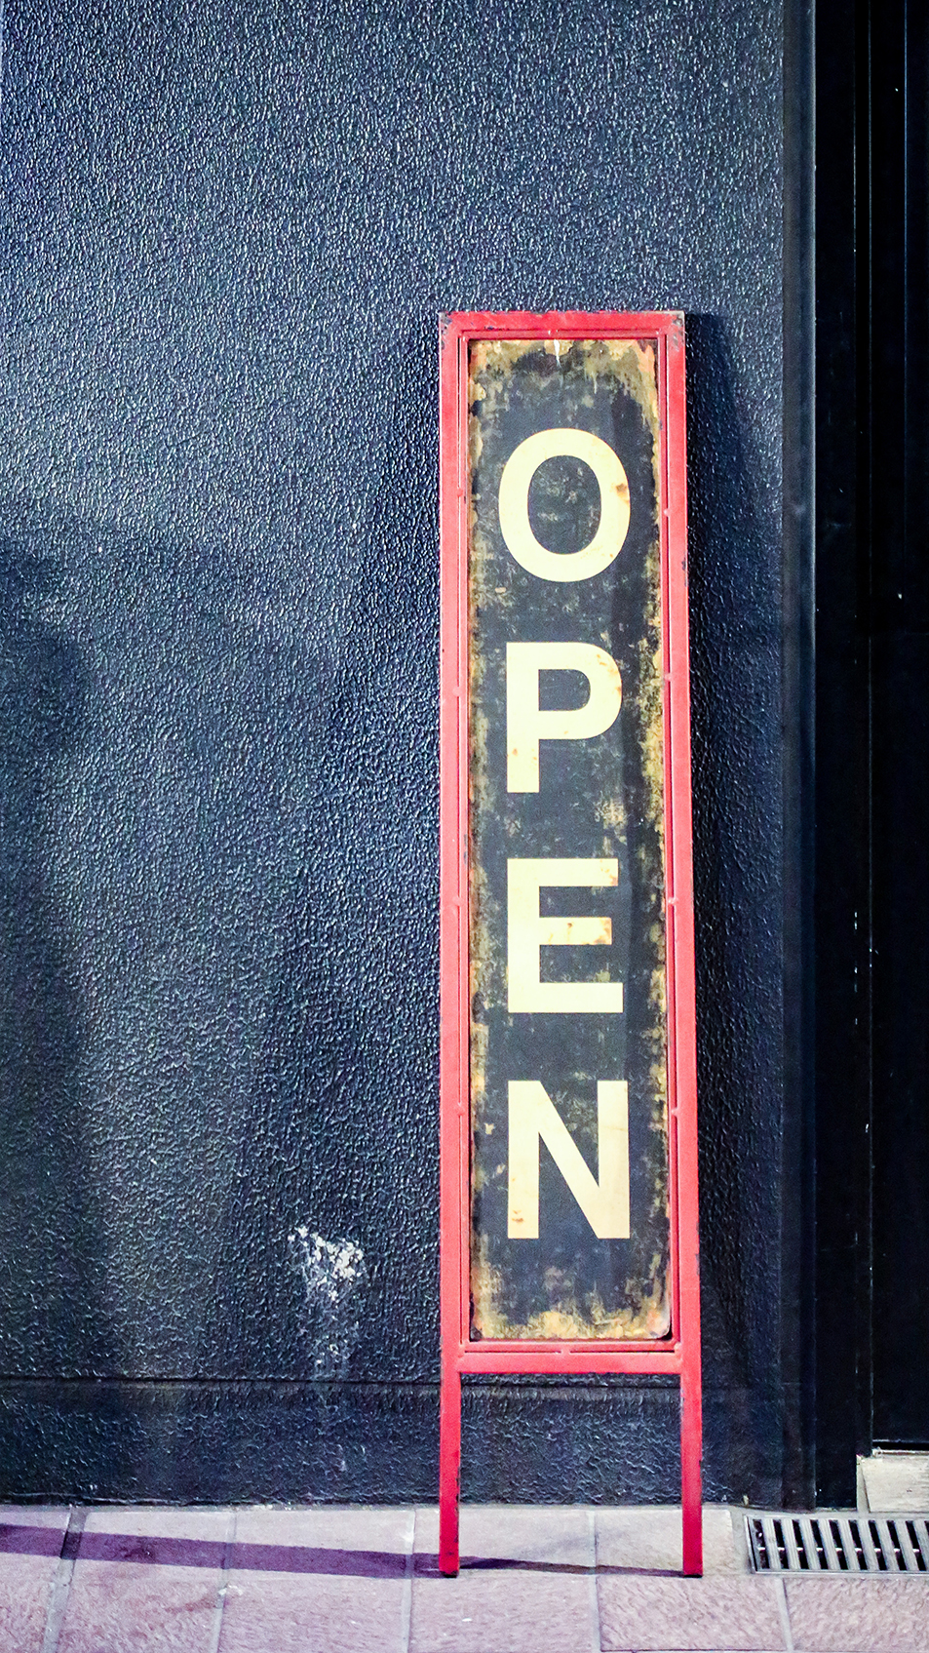
Product-Based Model
1
This model revolves around the creation and sale of physical goods. Companies invest in manufacturing or acquiring products to sell at a markup.
Examples: Retail stores, manufacturing firms.
2
Service-Based Model
Focuses on offering professional services rather than “products”. Revenue is generated by charging for the labour and expertise provided.
Examples: Consulting firms, marketing agencies.

Slide 44

Subscription Model
3
Charges customers a recurring fee — typically monthly or annually — to access a product or service. This model ensures steady revenue over time and builds customer loyalty. Examples: https://www.hellofresh.ie/ , Beauty Subscriptions and More | Birchbox
The trend in subscription services and usage by the public has changed the way many businesses operate. No longer are companies looking to make one-time sales. Instead, they want to have an ongoing relationship with their customers.
The Subscription Business Model: Definition, Examples, Advantages, and Disadvantages - StartUp Mindset and What’s a Subscription Business Model & How Does It Work? (hubspot.com)
Read more
This Photo by Unknown Author is licensed under CC BY-NC

Slide 45

Freemium Model
4
Offers basic services for free while charging for premium features. This model can attract a large user base and convert a portion to paying customers.
Examples: LinkedIn, Spotify.
5
Franchise Model
Licensing an operation including a brand and business model to franchisees in exchange for a fee or a share in the revenue.
Examples: McDonald’s, Subway.

Slide 46
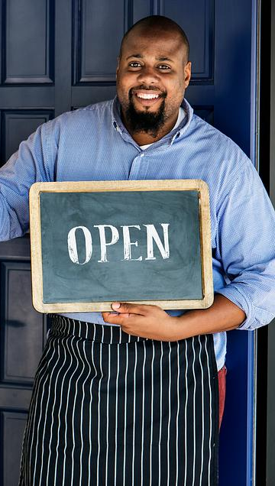
Marketplace Model
6
Connects buyers and sellers within a platform and earns money through fees or commissions from the transactions facilitated.
Examples: ETSY, eBay, Amazon.
7
Peer-to-Peer (P2P) Model
Facilitates transactions directly between individuals without the need for traditional intermediaries. This model is often used in accommodation, and services.
Example: Airbnb

Slide 47

Dropshipping Model
8
A retail fulfilment method where a store doesn’t keep the products it sells in stock. Instead, when a store sells a product, it purchases the item from a 3rd party and has it shipped directly to the customer.
Example: 13 Successful Dropshipping Store Examples For Inspiration (dropcommerce.com)
Entrepreneurs should choose a model considering long-term viability and alignment with their core competencies and values. Often, businesses may combine several models or evolve their strategies over time to respond to new opportunities and challenges.

Slide 48
Three ways to be in business
Based on your own cultural background, personal preferences and the opportunities you see, there are three key ways to be in business:-
Business enterprise - more focus on profit and wealth
Social enterprise - focus is solving societal issues for the benefit of community, e.g., tackle climate change environmental challenges, health and wellbeing
Community enterprise - use business to improve the life of a community
You will learn about the mechanics of each option later in this course.

Slide 49
05
Positioning is Key

Slide 50

Positioning is Key
Now that we've identified your personal motivations, entrepreneurial mindset, and unique strengths and considered key business models, it's essential to leverage these insights to understand your opportunity in the marketplace.
Understanding the competitive landscape will help you pinpoint where you can most effectively apply your strengths to meet market needs and differentiate from competitors.
To be truly effective, this step both analyses the market and strategically positions yourself in a way that maximizes your unique perspectives and skills.

Slide 51
Positioning is Key
1. Personal Insights
Utilise your understanding of personal motivations and strengths to identify market opportunities where these can be most effective. This alignment will ensure that your business is authentic and sustainable.
ACTION
Reflect on earlier assessments of your personal talents and motivations. Consider how these can solve problems or enhance value for your target market.

Slide 52
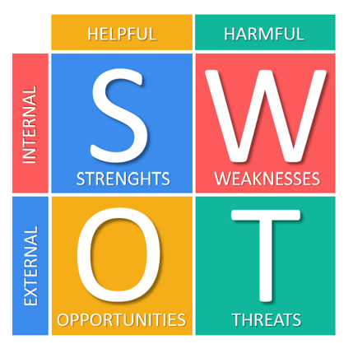
Understand your competitive landscape
2. Market Analysis
Conduct a thorough analysis of the industry to identify trends, size, growth, and the economic, social, and technological factors that could impact the market.
ACTION
Use analytical tools like a SWOT analysis to align market opportunities with your personal motivations and the unique strengths you’ve identified.

Slide 53
Example of SWOT Analysis in Action
Company Name: Green Bites
Business Idea: Green Bites is a start-up that delivers a monthly subscription box of vegan snacks to customers, sourcing products from ethical producers.
Strengths:
Unique Product Offering: Provides a curated selection of high-quality vegan snacks, appealing to health-conscious consumers and ethical eaters. They taste great.
Personal Founder Story: The founder is a well-known vegan chef and advocate for sustainable living, lending credibility and a personal touch that resonates with the target market.
Strong Relationships with Producers: Partnerships with local farms and small-scale producers ensure unique and high-quality product offerings

Slide 54
Example of SWOT Analysis in Action
Weaknesses
Limited Budget for Marketing: As a start-up, Green Bites has limited funds to invest in extensive marketing campaigns, which may slow down market penetration and brand recognition.
Supply Chain Complexity: Relying on multiple small producers can lead to potential supply chain issues, including inconsistent product availability and delivery delays.
High Product Costs: Sourcing ethically produced, high-quality ingredients often comes at a higher cost, which may need to be passed on to the customer, potentially limiting the market base.

Slide 55
Example of SWOT Analysis in Action
Opportunities
Growing Market for Vegan Products: The demand for vegan and plant-based products is increasing globally, providing a growing market to tap into.
Expansion to Other Niches: Potential to expand product offerings to include vegan meal kits, eco-friendly packaging solutions, or even branching into a vegan café or retail store.
Partnerships: Opportunity to partner with established food and health retailers to reach a broader audience and gain credibility.

Slide 56
Example of SWOT Analysis in Action
Threats
Competition: The market for vegan products is becoming increasingly crowded, with many new entrants and established players expanding their vegan offerings.
Economic Downturns: Economic instability can lead to consumers cutting back on non-essential purchases like subscription services.
Changes in Consumer Preferences: Shifts in consumer preferences or a decline in the popularity of the vegan lifestyle could impact demand.

Slide 57
Understand your competitive landscape
3. Competitor Analysis
Identify and evaluate direct and indirect competitors, focusing on how their offerings compare to the unique attributes you bring to the market.
ACTION
Analyse competitors' strengths and weaknesses against your own, focusing on areas where your unique strengths can give you a competitive advantage.

Slide 58
Example of competitor analysis
Competitor 1: VeggieCrunch Subscriptions. A well-established nationwide subscription service that offers a variety of vegan snacks.
Strengths:
  Brand Recognition: VeggieCrunch has a strong market presence with brand recognition Marketing Budget: Significant marketing resources that allow for frequent, high-impact advertising campaigns.
  Distribution Network: An extensive distribution network across all major urban centres.
Weaknesses:
  Generic Product Range: Although extensive, the product range is generic and similar to what's available in regular retailers
  Less Focus on Local Products: Limited engagement with local producers, focusing more on mainstream vegan products.
  Customer Service Complaints: Some recurring issues with customer service have been noted, affecting consumer satisfaction.

Slide 59
Example of competitor analysis
Competitor 2: EcoSnackBox. A niche startup that focuses on eco-friendly, zero-waste packaging with a variety of vegan snacks.
Strengths:
Eco-Conscious Branding: Strong appeal to environmentally conscious consumers due to its commitment to zero-waste packaging.
Innovative Packaging Solutions: Use of biodegradable and reusable packaging is a market differentiator
Engagement with Audience: Excellent social media engagement and community-building
Weaknesses:
Higher Price Point: The focus on eco-friendly packaging and processes results in a higher price point, which may alienate some budget-conscious consumers.
Scalability Issues: Challenges in scaling up operations while maintaining a commitment to eco-friendly practices.

Slide 60
Strategic Implications for Green Bites
Positioning is key. Niche is key. So, using these insights, Green Bites can effectively position itself in the competitive landscape. Each element of the strategy—from sourcing to marketing—must be carefully costed out to ensure it contributes positively to the overall business objectives and financial stability.
Unique Selling Proposition (USP): Highlight Green Bites' commitment to local and ethical sourcing as a key differentiator from competitors like VeggieCrunch.
Marketing Focus: Launch a targeted marketing campaign that tells the story of the local producers and the sustainable practices behind the snacks. This can involve video tours of farms, interviews with producers, and behind-the-scenes content that emphasises transparency and community impact.

Slide 61
Strategic Implications for Green Bites
Customisation Options: Offer personalised box options which EcoSnackBox and VeggieCrunch do not, allowing customers to tailor their subscription based on dietary preferences or snack types. Note the cost implication.
Leverage Personal Story: Use the founder's background as a vegan chef and sustainable living advocate to create an authentic brand story. Go big on profile building through blog posts, podcasts, and public speaking engagements that align the founder's personal ethos with Green Bites’ brand values.
Superior Customer Service: Put in place structures and resources for exceptional customer service by implementing a proactive support system that includes quick response times, personalised service, and active engagement on social media.

Slide 62

Positioning is Key
4. Customer Segmentation
Define your target audience more precisely based on the motivations and strengths that resonate with specific customer segments.
ACTION
Conduct deep market research to understand potential customers' preferences and pain points, particularly those that align with your strengths and business values.

Slide 63


The Value of Curiousity
There is a theory. You can't possibly be successful in business if you're not deeply curious about other people.
“Enjoy every step you take. If you're curious, there is always something new to be discovered in the backdrop of your daily life.”
― Roy T. Bennett, The Light in the Heart
Market research is the ultimate curiosity. It is a formula that can be easily learned and applied.

Slide 64
Customer Segmentation
Customer segmentation involves dividing a market into smaller groups of buyers with distinct needs, characteristics, or behaviours that might benefit from separate marketing strategies or products.
Key Segmentation Criteria
Demographic Factors: Age, income, gender, education level.
Geographic Factors: Urban vs. rural, local vs. national.
Psychographic Factors: Lifestyle, values (e.g., environmental consciousness), and attitudes towards health and sustainability.
Behavioral Factors: Purchase patterns, consumption rates, brand loyalty, and feedback.

Slide 65
Market Research, why is it needed?
Market Research is a logical and systematic search for new and useful information for your business. It is extremely important and useful to;
Measure the risk so you can decide if the risk is worth it, and you will proceed or not with your business idea
Inform you as to who your target audience is; who is the most profitable and valuable customer allowing you to align your products and services to their needs and wants
Asking your audience specific questions will get you valuable and honest feedback directly.

Slide 66
Types of Market Research
There are two main types of market research
Qualitative research (the WHAT)
Get reliable, facts and statistics to guide key business decisions e.g., how many target customers care about this benefit? All findings are factual, often numerical. The role of data is to empower you to make decisions based on facts, trends and statistical numbers. But with so much information out there, you must be able to sift through the noise, and get the right information, so that you can make the best decisions about strategy and growth.
Quantitative research involves collecting data through desk research, surveys, and questionnaires. Your job is to find it, organize it, analyse it and communicate it simply. This is the ‘what’.

Slide 67
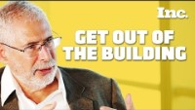
Types of Market Research
2. Qualitative research (the WHAT)
Qualitative research, as Steve Blank puts it, “get out of the building.” Main techniques are
In-Depth Interview
Focus Group
Market Research Online Communities (MROC) e.g. LinkedIn Groups
“Listening Platforms” i.e. blogs, forums etc
Questionnaires / Surveys - Online, face-to-face etc
Mystery Shopping
Observation
WATCH
Serial entrepreneur Steve Blank explains how entrepreneurs fail when they wait too long to gauge real customer interest in their products.

Slide 68
Conducting Market Research
Yes, market research is about gathering data, but it is really about understanding the pulse of the marketplace, enabling businesses to anticipate needs, outmanoeuvre competitors, and craft compelling offerings that speak directly to the heart of their audience. Approach it with detail and care..
Surveys and Questionnaires: Conduct surveys to gather data on customer preferences and buying behaviours. Tailor questions to uncover the attitudes of potential customers to your proposed products/service.
Focus Groups: Allow you to delve deeper into the motivations and reservations of potential customers
Data Analytics Tools: Utilise data analytics to sift through customer data collected via surveys, social media interactions, and website analytics to identify patterns and trends."

Slide 69
Positioning is Key
5. Value Proposition and Positioning
Equipped with personal strengths, market analysis and market research, define the specific niche or segment where your business will have the most impact. Positioning might focus on areas where your background or experiences provide unique insights or solutions.
It is about carving out a space where your products or services can stand out and meet specific needs that are not being fully addressed by others.

Slide 70

Understand your competitive landscape
6. Barriers to Entry and Strategic Positioning
Assess any barriers to entry in your chosen market, considering how your unique perspective and skills can help overcome these challenges.
ACTION
Develop strategies that leverage your personal and business strengths to navigate or dismantle these barriers effectively.
Let’s look at an example…..

Slide 71
Case Study Example
CulturaCrafts — Overcoming Barriers to Entry in the Craft Supplies Market
Background: CulturaCrafts is a start-up founded by Maria, an entrepreneur of Latin American descent, aiming to provide craft supplies that celebrate and promote Latin American cultures. The business focuses on supplying unique, high-quality crafting materials that are ethically sourced from artisans across Latin America.
Market Analysis: The craft supplies market is well-established with major players dominating the landscape, offering a wide range of products at competitive prices. Maria identified a niche market focusing on culturally specific craft supplies, which are not widely available in mainstream outlets.

Slide 72
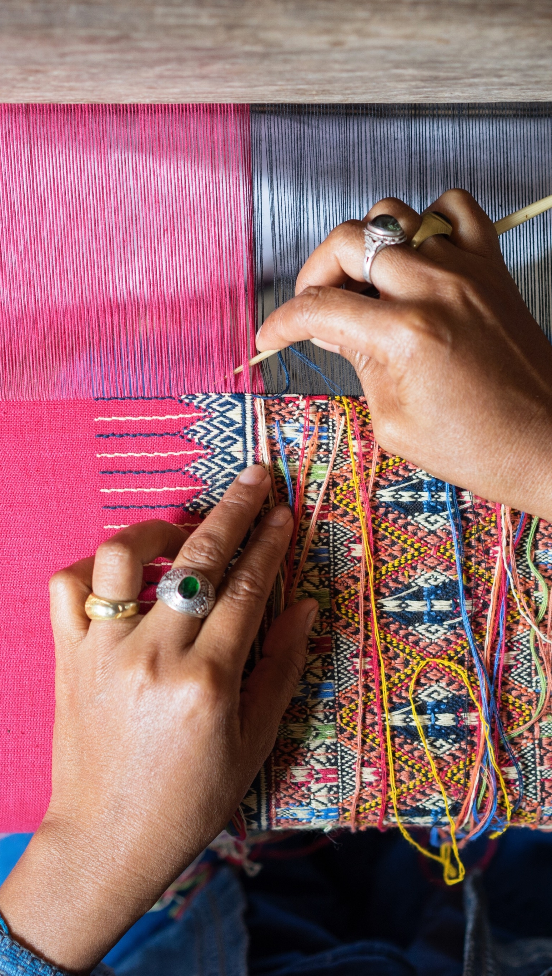
Strong Competition from Established Brands:
1
Large, established companies have economies of scale, extensive distribution, and brand loyalty, which can be intimidating for a new entrant like CulturaCrafts.
Strategic Positioning: Offer authentic, culturally rich products that large competitors do not provide.
2
Consumer Awareness and Market Education:
There is a lack of awareness and understanding among potential customers about the unique value of culturally specific craft supplies.
Strategic Positioning Implement educational marketing strategies that include storytelling about the artisans, the cultural significance of the materials, and DIY project ideas that use these supplies. Use social media platforms and events to build a community around the brand.

Slide 73

Supply Chain Complexity:
3
Establishing a reliable supply chain that involves international sourcing and fair-trade practices is complex and risk-prone.
Strategic Positioning Maria leverages her background and connections in Latin America to build strong, direct relationships with artisans, ensuring ethical sourcing and quality control.
4
Regulatory Compliance for International Trade:
Navigating the legal and regulatory requirements for importing goods can be daunting for a new business.
Strategic Positioning CulturaCrafts hires a consultant specialising in international trade laws to ensure compliance with all regulations, avoiding potential legal issues and fostering smooth operations.

Slide 74
Strategic Application of Strengths
Cultural Authenticity and Expertise: Maria’s deep understanding of Latin American cultures and crafts allows CulturaCrafts to offer unparalleled product authenticity, which is communicated through detailed product stories and artisan features.
Community Building: By creating an online platform and community for people interested in cultural crafts, CulturaCrafts establishes itself as more than a supply store but as a hub for cultural exploration and appreciation.
Partnerships and Collaborations: CulturaCrafts partners with cultural institutions, like museums and cultural festivals, to showcase products and conduct workshops, which helps in penetrating the market and building brand credibility.

Slide 75
Positioning is Key
7. Networking and Strategic Partnerships
Use your unique attributes to forge connections and partnerships that enhance your strategic position and market reach.
ACTION
Engage with networks and partners who value or share your entrepreneurial vision and can help amplify your impact.
Our training programme has content that will really help. Check out INSERT PIC OF
MODULE 4
Networking for Underrepresented Entrepreneurs

Slide 76

Well done on completing Module 1
Next up, Module 2, I have a business idea, now what?
www.mosaic4investing.eu

