Slide 1


MODULE 2
I have a business idea, now what?
www.mosaic4investing.eu

Slide 2
Introduction
01
Introduction to Business Idea Validation
Module 2 sees the focus shift towards thorough feasibility analysis to validate the business concept before moving forward.
This module will guide under-represented entrepreneurs/ founders through the essential steps of testing and refining their business ideas.
02
Understanding Feasibility Analysis
03
Minimum Viable Product (MVP)
04
Moving Forward with Your Validated Idea
05
Self-Reflection and References

Slide 3
Learning Outcomes
Knowledge:
Gain a thorough understanding of what feasibility analysis entails, including its importance in the business planning process.
Learn various techniques to validate their market, including how to develop and use a Minimum Viable Product (MVP).
Skills:
Acquire flexibility and responsiveness in the product development process
Critical thinking and strategic analysis to make informed decisions about the feasibility and potential of their business ideas.

Slide 4
Learning Outcomes
Behaviours:
Participants will adopt an iterative approach to product development, incorporating feedback to continuously improve their offering.
Attitudes:
Participants will cultivate an attitude of openness and receptiveness to feedback from all stakeholders, including customers and peers.
Participants will develop resilience, maintaining a positive and determined attitude even when faced with setbacks or negative findings during the market validation phase.

Slide 5
01
Introduction to Business Idea Validation

Slide 6
What is Business Idea Validation?
Vision and passion are not enough. Having identified a promising business idea and gained insights into the market landscape, the next essential step is validation. This crucial phase is about rigorously testing your business idea against the realities of the market and operational capabilities to ensure it is viable and capable of thriving in a competitive marketplace.
Purpose of Validation: Validation builds on initial assessments and spans …
Evaluating Product-Market Fit: Ensuring your product or service meets the needs and preferences of your target market.
Assessing Economic Viability: Analyzing whether the business can operate with financial stability and growth potential.
Testing Operational Feasibility: Understanding the practical aspects of launching and maintaining your business operations.

Slide 7
Why it Matters?
According to US data, but EU relatable, as reported in What Percentage of Small Businesses Fail? (fundera.com), approximately 20 percent of small businesses fail within the first year. By the end of the second year, 30 percent of businesses will have failed. By the end of the fifth year, about half will have failed. And by the end of the decade, only 30 percent of businesses will remain — a 70 percent failure rate.
Read More:https://entm.ag/QZniH3
In 2023, business failure rates in Europe saw a significant increase. According to the PwC Restructuring Update, in Q1 2023, the business failure rate rose by 19% compared to the same period in the previous year.

Slide 8
Why it Matters?
For under-represented entrepreneurs, the process of validation is a means to safeguard your venture against the common pitfalls that many startups face, while simultaneously building credibility and trust with potential investors, partners, and customers. In ecosystems where additional barriers may exist, a thoroughly validated business idea becomes a powerful tool. It goes some wat to level the playing field while showcasing your preparedness and business acumen.
However, validation goes beyond just overcoming barriers; it’s about having a comprehensive vision of the ecosystem and its culture. Under-represented founders often lack access to the same tools and networks that their counterparts might have, which can make it challenging to gain a full understanding of the market landscape. By focusing on validation, you’re proving the viability of your business idea and gaining invaluable insights into the ecosystem you’re entering.

Slide 9
This process involves…
Understanding the Market: Engaging with the market to understand its needs, preferences, and pain points.
Building Relationships: Establishing connections with stakeholders who can provide feedback and support.
Adapting to Culture: Learning the cultural nuances that can influence business operations and customer behaviour.
Leveraging Resources: Identifying and utilizing available resources, even if they are not immediately obvious.
By meticulously validating your business idea, you create a solid foundation that considers the full vision of the ecosystem, including its culture and the unique challenges it presents.

Slide 10
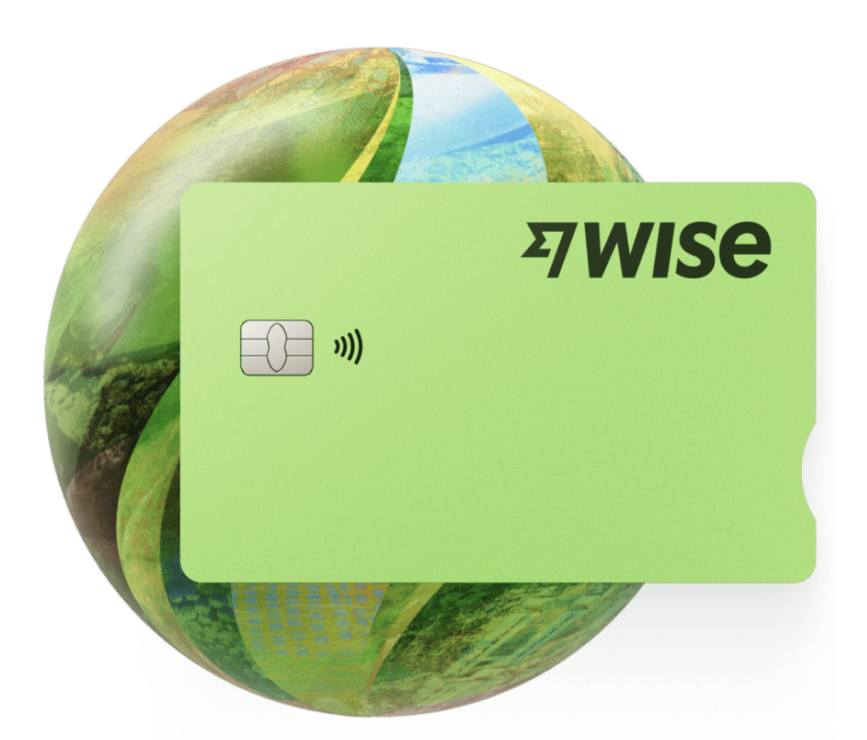
An Example of Idea Validation
Wise, formerly known as TransferWise
Founders: Taavet Hinrikus and Kristo Käärmann, both from Estonia, founded the company in January 2011.
What: Wise is a financial technology company that focuses on providing international money transfer services. It uses the real, mid- market exchange rates for transferring money abroad, which is often more cost- effective than traditional bank transfers.
Products: Multi-currency accounts that allows customers to hold balances in over 50 currencies and transact cross-border.
The Story of Wise - Wise

Slide 11
Validation Approach
Identifying the Problem: The founders validated their business idea by experiencing the problem firsthand. Taavet, the first employee at Skype, lived in London but got paid in euros. Kristo worked for Deloitte, also lived in London, and got paid in pounds but had a mortgage in euros back in Estonia. They both moved their money with their banks, which had expensive fees and bad exchange rates. They knew there had to be a better way, so they put their heads together and invented a beautifully simple workaround. This firsthand experience gave them a deep understanding of the problem they wanted to solve.
Testing with a Small Group: Initially, they tested their solution within a small network of friends and family. This allowed them to gather feedback and make necessary adjustments before a wider launch.

Slide 12
Validation Approach
Creating a Transparent Model: Wise differentiated itself by offering transparency in fees and exchange rates. They used the mid-market rate, which is the midpoint between the buy and sell prices of the currency, and charged a low, upfront fee.
Leveraging Word-of-Mouth: Satisfied customers began spreading the word about the service, which helped Wise grow organically. This word-of-mouth marketing was crucial in the early stages.
Focusing on Customer Experience: They prioritized customer experience, ensuring that the process was simple, fast, and reliable. Positive experiences led to repeat customers and referrals.
Iterative Development: Wise adopted an iterative approach, continuously improving their service based on customer feedback and the changing market landscape.

Slide 13
Validation Approach
Regulatory Compliance: They ensured compliance with financial regulations, which helped build trust with customers. This involved verifying the identity of users and adhering to anti-money laundering laws.
Expanding the Service: As the user base grew, Wise expanded their services to include more currencies and countries, further validating the demand for their solution.
Securing Funding: The traction they gained helped them secure funding from investors, which was a further validation of their business model and growth potential.
Public Listing: Eventually, Wise went public with a direct listing on the London Stock Exchange, which was a significant milestone and a testament to the success and validation of their business idea. WISE goes public on the London market | Fortune

Slide 14
02
Understanding Feasibility Analysis

Slide 15
Purpose of Feasibility Analysis
Feasibility analysis is conducted to evaluate the potential success of a new business idea or project before substantial time and resources are invested. It helps entrepreneurs identify possible obstacles, evaluate the likelihood of success, and determine if the idea should proceed, adapt, or be abandoned.
This analysis is especially crucial for under-represented entrepreneurs who may face additional barriers to resources, making every investment decision critical.

Slide 16
Conducting a Feasibility Study
Analysis and Evaluation:
In the next slides, we outline 5 key areas that need to be covered to arise at a feasibility conclusion, but please amend to suit your own business.
Market Feasibility | Technical Feasibility | Economic Feasibility | Legal Feasibility | Operational Feasibility

Slide 17
Components of Feasibility Analysis
Market Feasibility:
Involves researching the current market landscape to understand demand, customer demographics, competition, and market trends. The goal is to ascertain if there is a sustainable market for the product or service and how the proposed business can position itself competitively.
You started this process in Module 1.
Technical Feasibility:
Assesses the technical resources required to turn the idea into a tangible product or service. This includes evaluating the technology needed, the availability of technical skills, and the technical hurdles that may arise.

Slide 18
Components of Feasibility Analysis
Economic Feasibility:
Examines whether the financial aspects of a project are viable. It includes detailed cost and revenue projections, funding sources, and financial risks. This component is critical to ensuring that the business can be profitable and self-sustaining.
We have created 5 dedicated MOSAIC modules for finance and fundraising – check out Modules 3,4,5, 7 and 8
Legal Feasibility:
Checks for any potential legal issues associated with the business idea, including zoning laws, licensing requirements, and other regulatory constraints that could impact the ability to launch and operate the business.

Slide 19
Components of Feasibility Analysis
Operational Feasibility:
Look at the logistical aspects of setting up and running the business, assessing whether the operations can be carried out with the available resources, and what operational challenges could arise.
3. Synthesise the Findings
Now, bring together all the data and analyses to assess the overall feasibility of the business idea. This involves comparing the benefits and costs, weighing risks, and considering the operational and financial implications of moving forward with the business. Are clear conclusions arising ? As we covered in Module 1, utilise a SWOT analysis (Strengths, Weaknesses, Opportunities, Threats)

Slide 20
Conducting a Feasibility Study
4. Feasibility Report:
Compile the findings into a detailed feasibility report. The report should summarise the research, analysis, and conclusions, providing a clear and comprehensive overview of the viability of the business idea.
5. Decision Making:
Use the report as a basis for making an informed decision. Decide whether to proceed with the business idea, make necessary adjustments based on the findings. If the feasibility study shows significant hurdles that cannot be overcome, it might be wise to consider pivoting the idea or exploring different opportunities.

Slide 21

Feasibility is a Dynamic Tool
Treat the feasibility study as a dynamic tool. As conditions change or new information becomes available, revisit the study to ensure the business idea remains viable and relevant.

Slide 22
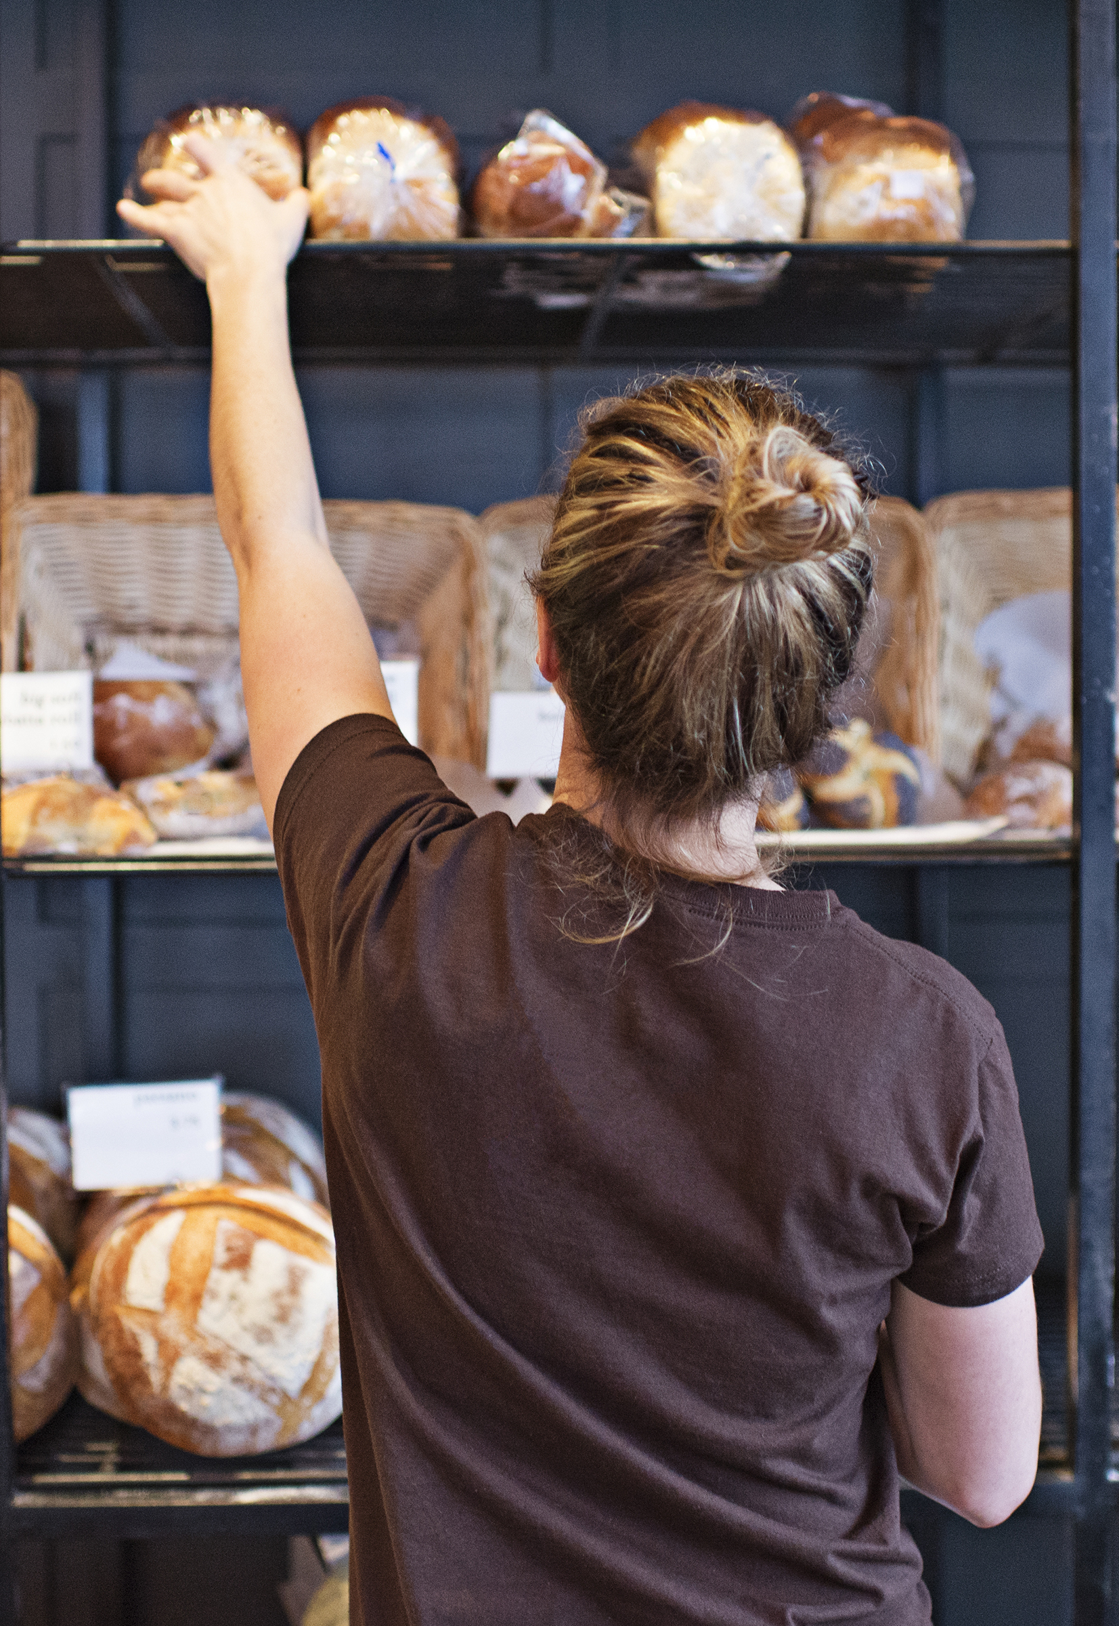
Feasibility Study in Action
Feasibility Study Example: Small-Scale Artisan Bakery in Belgium
Project Overview: Two second-generation migrants are considering opening a small-scale artisan bakery in Belgium, specializing in high-quality, handcrafted baked goods that blend traditional Belgian techniques with global flavours.
Objective: The primary objective is to assess the demand for unique, handcrafted baked goods that fuse international influences with local Belgian baking traditions, and to determine the viability of the business in a competitive market.
Michele Ruiz

Slide 23
Key Components of the Feasibility Study:
Market Analysis:
Local Demand: Conduct market research to understand local consumer preferences for artisan baked goods and their openness to new, culturally diverse flavours.
Competitive Landscape: Evaluate the presence and performance of existing bakeries, especially those offering artisan or culturally unique products. Complete a SWOT for each competitor and compare with yours to identify potential gaps in the market.
2. Financial Projections:
Start-Up Costs: Research costs related to acquiring a suitable location, purchasing baking equipment, initial ingredients, and other start-up necessities.
Product Costings and Break-Even Analysis: Calculate how much product needs to be sold to cover all operational costs, helping to understand the financial risks involved.
Revenue Projections: Project potential sales based on the pricing strategy, anticipated customer base, and potential wholesale opportunities.
Michele Ruiz

Slide 24
Key Components of the Feasibility Study:
3. Regulatory Requirements:
Licensing and Permits: Identify the necessary permits for operating a food business in Belgium, including food safety certifications and business operation licenses.
Health and Safety Regulations: Ensure compliance with Belgian health and safety standards for food production and sales.
Perspective:
Between elements in points 2 and 3, and when we add tax and social contribution structures (national and European), it is very challenging for new entrepreneurs. Explore in detail in your feasibility to avoid unpleasant surprises
Michele Ruiz

Slide 25
Key Components of the Feasibility Study:
4. Technical Feasibility:
Recipe Development and Production Planning
Production Technology: Determine the specific baking technologies and equipment needed to produce high-quality artisan breads and pastries.
Supply Chain: Assess the availability of high-quality local and international ingredients required for unique recipes.
5. Operational Considerations:
Location: Scout for strategically located retail spaces that attract significant foot traffic, such as city centres or local markets known for artisan products.
Staffing Needs: Plan for hiring skilled bakers who are proficient in diverse baking techniques, as well as sales and support staff.
Consider and cost marketing and sales tactics with branding that highlights the multicultural heritage of the bakery and a promotional plan to ensure sales targets are met.
Michele Ruiz

Slide 26
03
Minimum Viable Product

Slide 27
Minimum Viable Product
An MVP, or Minimum Viable Product, is a strategy used to quickly validate business ideas with minimal resources.
For underrepresented founders, who often face additional barriers in terms of access to capital and networks, the MVP approach is crucial. It allows for testing, learning, and iterating based on real customer feedback before making significant investments. The MVP is about smart resource management and learning:
Test Market Fit: Verify if there’s an actual demand for your product with the least effort.
Gather Insights: Collect valuable customer feedback to refine your offering.
Reduce Risk: Limit financial exposure by avoiding larger-scale investments upfront.

Slide 28

Building Your MVP: A Step-by-Step Guide
Creating a Minimum Viable Product involves identifying the most basic version of your product or service that will allow you to start the learning cycle with real users.
Let’s look at the steps involved:
Identify the Core Value Proposition:
Define the primary problem your product or service solves.
HOW? Method: Use your market research, interviews, surveys, and secondary research to pinpoint the needs and pain points of your target market. Focus on what is most essential to them.
  most essential to them.

Slide 29
Building Your MVP: A Step-by-Step Guide
Select Key Features: Choose features that directly address the core value proposition and are critical for solving the user’s problem.
HOW: As you define your product or service's features, consider the cost implications of each feature. This is where you start balancing what's essential for launch versus what can be added later, as each feature will impact the cost and, thus, the pricing.
Use tools like feature ranking, where potential users or team members score features based on importance and feasibility. Prioritise those that are essential for the initial launch.

Slide 30
Building Your MVP: A Step-by-Step Guide
3. Design a Simple Prototype: Develop a basic, functional model of the product that incorporates your selected features.
This step allows you to visualize and test the functionality of your idea, gather user feedback early in the development process, and identify any design or functional flaws before moving into more resource-intensive production stages.
HOW: Approaches to Prototyping: Digital Products
Wireframes: Start with basic wireframes to layout the structure and components of your digital product. Wireframes are typically low-fidelity designs that outline elements like navigation, content placement, and core UI features. Tools like Balsamiq are ideal for this because they are simple to use and focus on structure rather than aesthetics.

Slide 31

Building Your MVP: A Step-by-Step Guide
Mockups: Progress to higher fidelity mockups, which include visual design elements such as colours, logos, and typography. This stage is about refining the visual appeal and user experience. Sketch or Adobe XD are powerful tools for creating detailed and visually appealing mockups.
Interactive Prototypes: Develop interactive prototypes that users can click through to simulate the user experience. InVision and Figma offer capabilities to create prototypes that both look and behave like a finished product, allowing for more effective testing of user interactions.

Slide 32
Building Your MVP: A Step-by-Step Guide
Approaches to Prototyping: Physical Products
Concept Sketches: Begin with detailed sketches of the product to explore different designs and form factors. This traditional method is still highly effective for capturing ideas quickly and iterating on design.
3D Models: Use computer-aided design (CAD) software to create 3D models of your product. Tools like AutoCAD, SolidWorks, or even more accessible options like Tinkercad allow you to visualize the product in three dimensions, which is crucial for examining the ergonomics and functionality.
Prototype Fabrication: Move from digital or paper models to a physical prototype. Depending on the complexity and material, this could involve methods like 3D printing, CNC machining, or hand-building with simpler materials. Check out a FabLab facility. The goal is to produce a working prototype that reflects the product’s design and can be used for testing.

Slide 33
Building Your MVP: A Step-by-Step Guide
Develop the MVP: Turn the prototype into a usable product with pricing.
HOW. Use the leanest development methods available. For software, this might mean coding the simplest functional version of the application. For physical products, create a small batch using cost-effective manufacturing processes.
Revenue Models: Develop and test different scenarios based on various pricing strategies. This might include
Value Proposition and Pricing: Align your pricing strategy with your value proposition. If you’re offering a premium product, your price should reflect that. Conversely, if you’re aiming to offer a cost-effective solution, your pricing needs to appeal to a more price-sensitive segment.
Competitive Positioning: Set your prices in a way that positions your business competitively in the market.

Slide 34
Building Your MVP: A Step-by-Step Guide
Define Success Metrics: Establish clear, measurable goals for the MVP to assess its performance.
By defining clear, measurable goals, you can determine whether your MVP is meeting the market's needs, where it might be falling short, and the changes necessary before wider deployment.
HOW. Establishing Metrics: Digital Products
User Acquisition Metrics: Number of sign-ups, app downloads, website visits. Engagement Metrics: Daily or monthly active users, session length, page views per visit, and interaction rates with key features. Tools like Google Analytics can provide comprehensive data on how users interact with your product.
Conversion Metrics: Conversion rates from visitor to user, user to paying customer, or completion of other desired actions (e.g., filling out a form, subscribing to a newsletter).

Slide 35
Building Your MVP: A Step-by-Step Guide
HOW. Establishing Metrics: Physical Products
Sales Metrics: Number of units sold, speed of inventory turnover, and order size. These metrics assess the market demand and sales velocity of your physical MVP.
Customer Satisfaction: Net Promoter Score (NPS), satisfaction ratings, and return rates. Collect this data through direct feedback forms included with the product or digital feedback platforms linked via QR codes on packaging. NPS is a widely used metric in business to measure customer satisfaction and loyalty. It is a straightforward tool that asks customers a single question - "On a scale of 0 to 10, how likely are you to recommend our company/product/service to a friend or colleague?"
Product Usage and Reliability: Frequency of use, product life span before failure, or incidents of product returns due to defects.

Slide 36

Building Your MVP: A Step-by-Step Guide
HOW. Establishing Metrics: Services
Client Acquisition and Retention Rates: Measures how many clients are attracted to the service and the rate at which they return or subscribe for an extended period.
Service Quality Metrics: Customer satisfaction surveys, service speed, and compliance with service level agreements (SLAs). These metrics are crucial for understanding how well the service meets client expectations.
Operational Efficiency: Measures such as time to deliver a service, cost per service delivery, and resource utilisation rates. These help in assessing the efficiency and scalability of the service model.

Slide 37
Building Your MVP: A Step-by-Step Guide
Some free service management software that can help in this phase
Zoho Desk is part of the Zoho suite that offers a free plan for those who need basic help desk features. It includes email ticketing, knowledge management, and a help center for customers.
HubSpot Service Hub offers a free version of its Service Hub that includes ticketing, live chat, and team email features, as well as reporting dashboards to track customer requests and feedback efficiently.
Freshdesk provides a free plan called the 'Sprout' plan, which offers email and social ticketing, a knowledge base, and ticket trend reporting
Trello (with service management templates). While primarily a project management tool, Trello can be effectively used for service management with templates and can integrate with other apps to enhance functionality.

Slide 38

Building Your MVP: A Step-by-Step Guide
6. Prepare for Launch: Get your MVP in front of real users to start gathering data.
HOW: Plan a small-scale launch that targets a segment of your potential customer base. Consider sales channels like a soft launch online, participation at a trade or consumer event (where your target customers can be reached), or a limited release in a controlled environment.
7. Feedback Loop: Create a system for collecting and analysing user feedback effectively.
HOW: Implement simple feedback tools such as user surveys, one-on-one interviews, or usability tests. For digital products, consider using features within the app or website to prompt user feedback directly after use.

Slide 39
EXAMPLE: Building Your MVP: A Step-by-Step
Background: Lena, a social entrepreneur with a background in urban planning and personal experience with mobility impairments, has noticed significant accessibility challenges in urban areas, from public buildings to transportation systems. She is motivated to improve this by setting up a consultancy business.
Identify the Core Value Proposition
Identify the Problem: Urban environments often lack the necessary accommodations for people with disabilities, making navigation and access to services challenging and limiting their participation in community and economic activities.
Lena’s business, Access Urban, is a consultancy service that will help city planners, businesses, and public institutions design and retrofit urban spaces to be fully accessible for people of all abilities.

Slide 40
EXAMPLE: Building Your MVP: A Step-by-Step
Perspective: Lena's journey as a social entrepreneur with a disability gives her a unique vantage point in the urban planning industry, traditionally not diverse in terms of disability representation.
2. Define the MVP Features
Lena's Approach: Leveraging her urban planning expertise and personal insights into mobility challenges, Lena selects the most critical service offerings that demonstrate immediate value to potential clients.
Initial Service Offering: Lena decides to focus on accessibility audits, which are comprehensive evaluations of public spaces to assess their current accessibility and provide recommendations for improvement.
Key Features: These audits will include detailed site inspections, accessibility compliance checks against national standards, and practical, innovative recommendations tailored to each location.

Slide 41
EXAMPLE: Building Your MVP: A Step-by-Step
3. Design a Simple Prototype:
Lena's Prototype Development: Using her past project experience, Lena creates a detailed sample audit report. This report outlines potential barriers in urban spaces and suggests specific modifications to enhance accessibility.
Tools: Lena utilises CAD software to create visual modifications and improvements in the report. She also develops a professional portfolio on her newly designed but basic website, which showcases sample reports and visual illustrations of potential improvements.

Slide 42
EXAMPLE: Building Your MVP: A Step-by-Step
4. Develop the MVP: Optimising MVP Development for Access Urban
Lena needs to establish strong relationships with public authorities responsible for enforcing accessibility standards and commissioning public infrastructure projects.
Build Awareness: Lena actively participates in city council meetings, public planning sessions, and workshops related to urban development. She offers insights, draws on her personal experiences, and provides constructive feedback on proposed plans, gradually building her reputation as a knowledgeable and passionate advocate for accessibility.
In terms of overcoming barriers, Lena could opt for a crowdfunding approach to overcome funding biases, showcasing her project directly to potential users and allies who understand and value her mission.

Slide 43
EXAMPLE: Building Your MVP: A Step-by-Step
4. Develop the MVP: Optimising MVP Development for Access Urban
Offer a Pilot Audit: Lena approaches library management and local government officials responsible for public building maintenance with a proposal for a free accessibility audit for an old library in her community. She presents this as a win-win opportunity: the library gains valuable insights and recommendations at no cost, and Lena gains a showcase project for her portfolio.
In terms of overcoming barriers, Lena's audits go beyond compliance; they reflect real-world usability enhancements based on lived experiences, setting her services apart from conventional consultancies. Her business style is to work with clients as collaborators, co-designing solutions that are truly inclusive and effective.

Slide 44
EXAMPLE: Building Your MVP: A Step-by-Step
4. Scaling the MVP:
Scope and Scale: Lena selects one to three pilot projects to maintain manageability and ensure quality. She chooses projects that vary in scale and complexity, such as a small public park, a community centre, and a private development undergoing renovation.
Metrics for Scaling: Success metrics for scaling include client satisfaction, the rate of implementation of her recommendations, and subsequent referrals from pilot projects. Positive outcomes will validate a broader roll-out of her services.
Scale-Up Pricing: Post-pilot, Lena plans a tiered pricing model based on the scope of the project and the client type (public vs. private sector). This model will reflect the complexity of the work and the value it brings in terms of compliance, usability, and public image enhancement.

Slide 45
EXAMPLE: Building Your MVP: A Step-by-Step
5. Feedback Integration
Structured Follow-Up Meetings: Lena schedules follow-up meetings with all stakeholders after the implementation of her recommendations. These meetings are designed to assess client view on the impact of the accessibility audit, discuss any challenges, and gauge overall satisfaction.
Digital Surveys: Lena develops and distributes digital surveys to a broader audience, including library patrons and employees, to gather specific feedback on various aspects of the recommended accessibility enhancements and the audit process itself.
Testimonial Collection: If clients are satisfied with the outcomes, Lena requests written or video testimonials that can be used for marketing purposes and to build trust with potential clients.

Slide 46
EXAMPLE: MVP Development, Lena’s Differentiating Factors
Advantages:
Authentic Insight: Lena's personal experience with mobility impairments provides her with authentic insights into accessibility needs, making her service offerings inherently user-centric and deeply empathetic.
Community Trust: Her status as a member of the disabled community helps build immediate trust and rapport with her target audience, facilitating more open feedback.
Challenges:
Bias in Funding: Encountering biases from potential investors who may underestimate Lena’s capabilities due to her disability, impacting her ability to secure initial funding.
Resource Limitations: Limited access to certain networking opportunities that non-disabled peers might take for granted, affecting early-stage visibility and partnerships.

Slide 47
04
Moving Forward with Your Validated Idea

Slide 48

Moving Forward
After successfully developing a feasibility study and testing your Minimum Viable Product (MVP), you've gathered valuable insights into the market's needs and your product or service potential. This initial validation is crucial, but it's just the beginning.
Now, it’s time to leverage the momentum and lessons learned from your MVP to scale your operations, enhance your offerings, and launch your business.
The next steps involve expanding upon the strong foundation you've built, addressing broader markets, and implementing robust systems to support sustainable growth.

Slide 49
What we know so far
We have compiled and analysed all feedback from our MVP, which encompasses both qualitative insights from customer interactions and quantitative data such as cost of product, production or service inputs and even sales figures.
We are beginning to see how our business model stacks up against industry norms and our initial expectations. This allows us to pinpoint the most effective areas of our business and those that require strategic adjustments. Module 1 Section 4 is insightful in terms of understanding business models. Have we picked the best fit model for our business? Based on user feedback, we're prioritising feature enhancements and quality improvements that directly enhance user satisfaction and product functionality.

Slide 50

What we know so far
We are refining our pricing strategy to align more closely with customer value perception and market demand.
Insights from discussions with stakeholders, including team members, partners, and advisors, have been invaluable. They've provided a broader perspective on operational effectiveness and market positioning.

Slide 51

Moving Forward
We have come so far, but the road is long. As you stand at this juncture, reflecting on your progress and looking toward the future, it's important to recognise the milestones you’ve achieved and the hurdles you've overcome.
It’s not too early to celebrate your achievements.
Detail the key milestones achieved in your journey so far, such as successful MVP development, critical feedback integration, and initial market penetration.
Highlight the valuable lessons that are shaping your emerging business strategy and growth. Own and recognise how these lessons are pivotal in preparing for the challenges ahead.

Slide 52

Moving Forward
2. Acknowledge Current Obstacles.
Identify the significant challenges currently facing the business, such as scaling operations, diversifying product lines, or penetrating new markets.
Craft how you are going to overcome these obstacles, including innovations in product development, enhancements in customer engagement, and strengthening of operational capacities.

Slide 53

Moving Forward
3. Go back to your WHY.
Remember your emotional foundation, the moment this idea was born, the challenges that moved you, and the vision that inspired you to start.
Reiterate the long-term vision for the business.
How does the company see itself evolving in the next five years?
What impact do you aspire to make in your industry or community?
Renew your commitment to your core values and vision

Slide 54

WATCH
Simon Sinek’s Start with WHY is a great watch.
Simon is an unshakable optimist. He believes in a bright future and our ability to build it together. Described as “a visionary thinker with a rare intellect,” Simon has devoted his professional life to help advance a vision of the world that does not yet exist; a world in which the vast majority of people wake up every single morning inspired, feel safe wherever they are and end the day fulfilled by the work that they do.
Simon is the author of multiple best-selling books including Start With Why, Leaders Eat Last, Together is Better, and The Infinite Game.
https://youtu.be/Oh2KRQPaKOU

Slide 55

“What good is an idea if it remains an idea? Try”.
Simon Sinek

Slide 56
Moving Forward
3. Go back to your WHY.
Remember your emotional foundation, the moment this idea was born, the challenges that moved you, and the vision that inspired you to start.
Reiterate the long-term vision for the business.
How does the company see itself evolving in the next five years?
What impact do you aspire to make in your industry or community?
Renew your commitment to your core values and vision

Slide 57

Next Steps in Moving Forward with Your Validated Idea
Safeguard your Idea – 4 Aspects of Intellectual Property Protection:
Patents: If appropriate, file for patents to protect your innovative products or unique processes from being copied or used without permission. Patents provide a legal right to exclude others from replicating your invention for up to 20 years. But it can be an expensive process.
Copyrights: Secure copyrights for original works such as written content, software, graphics, and marketing materials. Copyrights prevent others from using your original work without consent and last for the life of the author plus 70 years.

Slide 58
Next Steps in Moving Forward with Your Validated Idea
Safeguard your Idea – 4 Aspects of Intellectual Property Protection:
3. Trademarks: Register trademarks for your brand name, logos, and slogans. Trademarks protect the symbols and words that represent your brand to the public, preventing others from using similar signs that could cause confusion.
4. Trade Secrets: Protect confidential business information through non-disclosure agreements and proper internal security measures. This includes recipes, practices, or designs that give you a competitive edge.

Slide 59
ACTION: Intellectual Property Protection Worldwide and Nationally
World Intellectual Property Organization (WIPO): WIPO - World Intellectual Property Organization
Although WIPO is a global organisation, it provides essential tools and databases that are useful for EU-based entities, including international patent searches and resources on various aspects of intellectual property law.
Each EU country has its own national intellectual property office that provides specific guidance and resources relevant to that country’s legal framework. These offices often offer detailed guides, services for registering IP, and educational seminars.
Germany: German Patent and Trade Mark Office DPMA | Trade Marks
France: National Institute of Industrial Property INPI.fr | Welcome to the home of innovators

Slide 60
Building a Strong Online Presence
You may have built a basic website during your MVP process, but it is time to build on that process or start with a new website development.
Secure a strong domain
Invest as much as you can in a professional website. If your initial webpage was put together quickly or without professional help, consider investing in a professional website designer to enhance the visual appeal and usability.
Ensure that your website is responsive. Map out the user journey to ensure it is as intuitive as possible. Simplify navigation, streamline content, and ensure that calls to action (CTAs) are clear and compelling.
Additional features. As you approach a full business launch, consider adding new features such as e-commerce capabilities, user forums, customer support chatbots, or interactive tools.
Security Enhancements. Ensure your website is secure, especially if you handle sensitive user data. Implement security measures such as SSL certificates, regular security audits, and compliance with relevant data protection regulations like GDPR.

Slide 61
Building a Strong Online Presence
It’s never too early to plan your social media strategy.
Focus on platforms where your target audience is most active. Where do your target audience spend most of their time online? Focus on two or three platforms that best align with your audience's preferences and your business goals. For instance, if targeting a younger demographic, Instagram and TikTok might be priorities, whereas a B2B focus might lean more towards LinkedIn.
Capture an email marketing list. Implement strategies for capturing email addresses more effectively. This can include offering incentives such as free downloads, exclusive content, or first-order discounts in exchange for email signups.
It’s never too early to plan your social media and email marketing strategies.
Check out Module 8 Marketing and Sales for Underrepresented Entrepreneurs
to plot a plan for this vital area

Slide 62
Building a Strong Team
You may have started on this adventure on your own. But building a strong team is crucial as your business grows. It is a key factor in investor decisions. Transitioning from a solo endeavour to a collaborative business environment can significantly enhance your capacity for innovation, execution and investment.
Assemble a team that covers critical business areas—operations, marketing, finance, and product development.
Show that your team has the skills and experience to execute the business plan successfully.
Advisory Board: Consider forming an advisory board of experienced professionals who can provide strategic advice and enhance your credibility with investors.

Slide 63
Solidifying Your Business Plan
Bring all you now know into a robust Business Plan….
Detail your business model, market analysis, competitive landscape, sales and marketing strategy, operational plan, and financial projections: Share learnings from feasibility study and MVP and validation for the demand for your product or service. | Iterative Development: Show that you’re responsive to feedback and have iterated on your product based on real user input, enhancing product-market fit. | Great clarity and communication in your value proposition: Clearly define what makes your business unique and why it is a viable investment | The team: Show that your team has the skills and experience to execute the business plan successfully.

Slide 64

Solidifying Your Business Plan
Bring all you now know into a robust Business Plan….
Understanding Financials and Funding Needs:
Detail your revenue streams and provide realistic financial projections.
Be transparent about your assumptions and the risks involved.
Outline how much funding you need, what it will be used for, and how it will help your business grow.
Be specific about the milestones you expect to achieve with this funding.

Slide 65
Getting Your Business Up and Running: Preparing for Investment
Transitioning into securing funding for your business and preparing for investment conversations are the next critical stages.
Our MOSAIC course has you covered!
Module 4: How Do I Secure Funding for My Idea? | Module 5: How Do I Manage My Finances | Module 8: Financial Aid for Under-Represented Entrepreneurs, Mediation

Slide 66
05
Self-Reflection and References

Slide 67
EXERCISE 1: Business Idea Validation
Objective: To help learners critically assess the viability and potential impact of their business idea before moving forward.
Exercise:
Creating a dynamic and interactive template for evaluating your business idea in a tool like Miro to make the process visually intuitive. Miro is an online collaborative whiteboarding platform that can help visualize concepts and facilitate brainstorming sessions effectively. Lots of functions can be achieved with a free account.
Other options include Mural is a collaborative intelligence company | Mural, Cacoo | Online diagramming tool for collaborative diagramming | Nulab and Secure Collaboration Tool for Hybrid teams | Conceptboard

Slide 68
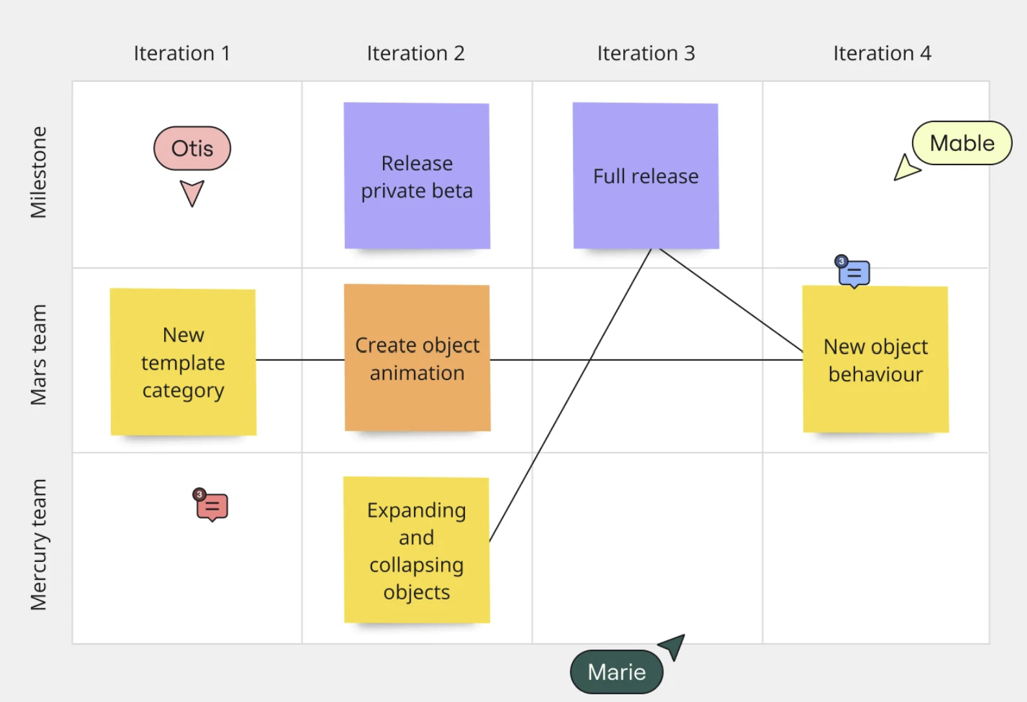
Steps to Create a Business Idea Evaluation Board in Miro
  Create a New Board:
  Log into Miro or sign up if you don’t already have an account.
  Start a new board from the dashboard.
  Use the frame tool to create separate sections for each evaluation criterion.
  Title each frame with a criterion such as Market Size, Target Audience Fit, Initial Cost Analysis, Scalability, and Potential Challenges.
  Inside each frame, use sticky notes or text boxes to add descriptions or questions that guide what specific aspects users should consider for each criterion
  For example, under Market Size, you might ask: What is the estimated size of your target market? What are the growth projections?
Michele Ruiz
GET STARTED
How To Use Miro | Your Guide To Getting Started

Slide 69
Steps to Create a Business Idea Evaluation Board in Miro
Now Get Interactive :
Incorporate polls or voting stickers within each frame to allow trusted collaborators to rate how well the business idea meets each criterion.
Use arrows or connecting lines to show relationships or dependencies between different factors.
Enable comments for team members to provide detailed feedback directly on the board.
Use icons and markers to visually represent different aspects of the analysis, like risks, opportunities, and strengths.
Add Resources
Link to external resources, research papers, or market analysis reports directly in the relevant sections for easy access during discussions.Embed images or videos that provide additional context or exemplify similar business model analyses.
Michele Ruiz

Slide 70
Steps to Create a Business Idea Evaluation Board in Miro
Preparation for Review:
Arrange a section at the bottom or side of the board for final thoughts and overall assessment
Prepare a summary area where key takeaways and decision points can be highlighted after the evaluation
Invite Participants:
Share the board with your team members, mentors, or advisors.
Schedule a live session where everyone can contribute in real-time, making the session more dynamic and collaborative
Save and Export Options:
Ensure all changes are saved and offer participants the ability to export the board as a PDF for further review or documentation purposes
Michele Ruiz

Slide 71
EXERCISE 2: MVP Planning and Feedback Loop
Objective: To help learners apply lean startup principles to build a product with minimal features that fulfil customer needs and to establish a process for iterative development based on real user feedback.
1. Define the MVP's Purpose:
Task: Identify and write down the primary problem your MVP will solve. Clarify how it aligns with the needs of your target market.
Tool: Use tools like customer persona templates and problem statement frameworks to clearly define the problem and how your MVP addresses it.
These tools include VISME (see next page) User Persona Template | Cacoo | Nulab and Userpilot 11 User Persona Examples and Templates to Create Your Own

Slide 72
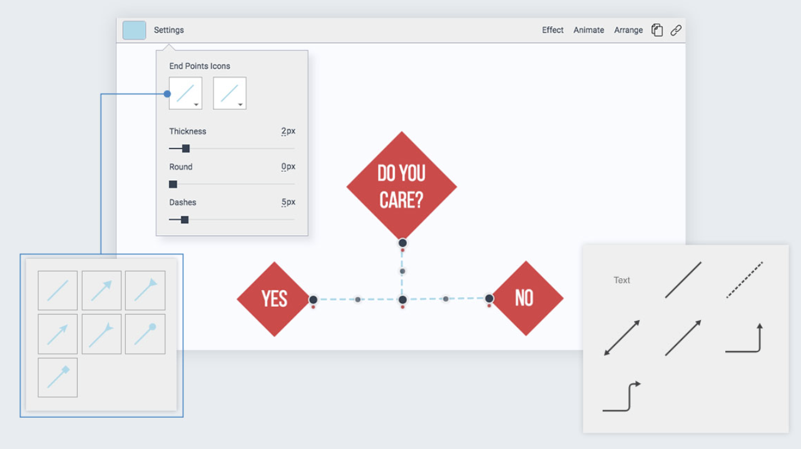
Steps to Progress VISME Tool for MVP Planning and Feedback Loop
2. Identify Core Features
Determine the essential features that your MVP must include to effectively address the primary needs of your target market. Prioritize these features based on their potential impact and feasibility.
Using Visme: Create feature prioritization grids or employ the MoSCoW method (Must have, Should have, Could have, Won't have this time) using Visme’s customizable charts and templates to visualize these priorities.
Action: Choose a chart or grid template in Visme and list your features, using different colours or symbols to denote priority levels.
Michele Ruiz
WATCH: https://youtu.be/Ve3JZtWrFh0?si=qFDGtw_ztKbnEtVH

Slide 73
Steps to Progress VISME Tool for MVP Planning and Feedback Loop
3. Develop the MVP
Task: Build a basic version of your product that incorporates only the core features. This version should be functional enough to meet the primary needs and be viable for introduction to early adopters.
Using Visme: Use Visme to sketch out the MVP’s layout or architecture visually. You can create flowcharts or mockups directly in Visme that represent the user interface and user experience.
Action: Design a simple product mockup or an architectural diagram in Visme that illustrates how the MVP functions from a user’s perspective.
4. Set Up Feedback Mechanisms
Task: Establish effective channels and tools to collect feedback from the initial users of your MVP. This could include surveys, interviews, and usage data analytics.
Using Visme: Design interactive surveys or feedback forms in Visme that you can integrate into your MVP or send to users after they test the product.
Action: Create a visually appealing survey in Visme, customize it to fit your brand, and embed or share it with your users.
Michele Ruiz

Slide 74
Steps to Progress VISME Tool for MVP Planning and Feedback Loop
5. Collect and Analyze Feedback
Task: Systematically gather feedback as users interact with your MVP. Pay attention to both the qualitative insights and quantitative data.
Using Visme: Compile and visualize feedback data using Visme’s data visualization tools such as graphs, pie charts, and heat maps.
Action: Regularly update your visual data in Visme as new feedback comes in, enabling real-time analysis and quick response to user needs.
6. Iterate Based on Feedback
Task: Refine your MVP based on the feedback: modify features, fix issues, and possibly add new elements that users have indicated are missing.
Using Visme: Update your MVP diagrams and mockups in Visme to reflect each iteration. Use Visme’s presentation tools to document changes and communicate updates to stakeholders.
Action: Maintain an iterative log in Visme, showcasing the evolution of your MVP with each feedback cycle.
This structured use of Visme helps maintain clarity and efficiency throughout the MVP development process, making complex information and changes easier to manage and understand.
Michele Ruiz

Slide 75

Well done on completing Module 2
Next up, Module 3, Financial Literacy and business planning for under represented founders
www.mosaic4investing.eu

