Slide 1


Module 10
Operations and
Resource Management
www.mosaic4investing.eu

Slide 2
Module Overview
01
Introduction to Operations and Resource Management
Designed specifically for under-represented entrepreneurs, Module 10 equips learners with practical tools, skills, and strategies to help them streamline operations, manage resources wisely, and prepare their businesses for sustainable growth
02
Supply Chain Management and Optimization
03
Operational Efficiency and Scalability Strategies
04
Managing Quality and Continuous Performance Improvement
05
Reflection and Self Assessment

Slide 3
Learning Outcomes
Operational efficiency and scalability
Lean methodologies and Six Sigma
General
Effective resource allocation and cost control
Supply chain management and Quality Control

Slide 4
Learning Outcomes
Knowledge
Operations Management: Learners will understand the key components of operations management, including resource allocation, supply chain optimization, and quality control.
Supply Chain Management: Participants will learn the principles of supply chain management, supplier selection, logistics, and risk mitigation strategies.
Budgeting and Cost Control: Learners will gain a foundational understanding of budgeting, financial forecasting, and cost control techniques essential for operational efficiency.
Lean and Six Sigma: Learners will become familiar with Lean and Six Sigma methodologies to identify and eliminate inefficiencies and improve process quality.

Slide 5
Learning Outcomes
Skills
Process Optimization: Ability to create and apply lean process maps to streamline workflows and reduce waste.
Budgeting and Cost Control : Skills in developing operational budgets, forecasting financial needs, and managing cash flow effectively.
Resource Allocation: Practical ability to use tools like the resource allocation matrix and vendor scorecards to optimise resource distribution.
Scaling Operations: Learners will develop the ability to automate processes and use technology to efficiently scale operations as the business grows.

Slide 6
Learning Outcomes
Behaviours
Proactive Planning: Learners will adopt proactive approaches to planning and managing resources, avoiding pitfalls of overspending or inefficiency.
Continuous Improvement: Lean thinking will become second nature, with participants continuously seeking ways to reduce waste and optimise processes.
Data-Driven Decisions: Learners will make decisions based on data, using tools like financial forecasts, supply chain metrics, and performance dashboards to guide operational improvements.
Resilience in Scaling: As businesses grow, learners will be prepared to scale sustainably without sacrificing quality or efficiency.

Slide 7
Learning Outcomes
Attitudes
Growth Mindset: Learners will develop an entrepreneurial mindset focused on continuous improvement and sustainable growth.
Customer-Centricity: A focus on value creation and customer satisfaction will shape business operations, with processes aligned to deliver consistent quality.
Efficiency-Oriented: Learners will value efficiency and resource optimization as foundational principles for operational success.
Collaboration: They will also appreciate the importance of strong supplier and team relationships in driving business performance.

Slide 8
01
Introduction to Operations and Resource Management

Slide 9

Operations management is the backbone of any business. Without efficient operations, growth is unsustainable.
William J. Stevenson
This Photo by Unknown Author is licensed under CC BY-SA-NC

Slide 10
Overview of Operations & Resource Management
Operations management involves planning, organizing, and controlling resources to convert inputs into outputs efficiently. For under-represented entrepreneurs, resource management is crucial for business survival and growth.
Operations Management: The coordination of activities to produce goods or services. This includes managing human resources, finances, and materials.
Resource Allocation: Refers to how resources (time, money, equipment, personnel) are distributed to maximise productivity and efficiency, a significant challenge for small businesses with limited capital.
Why It Matters: Successful operations management and resource allocation can lead to better efficiency, cost reduction, and scalability, all of which are vital for sustaining growth in competitive markets.

Slide 11
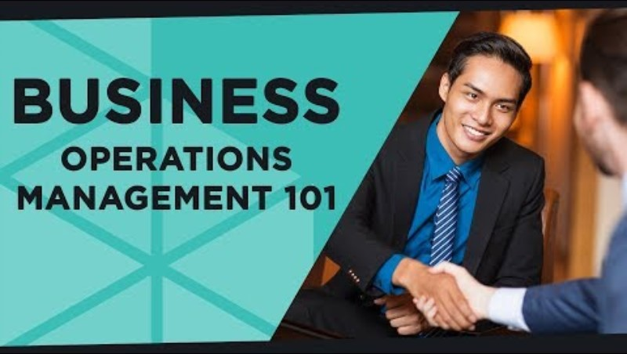
Be inspired by..
A brief video introducing the notion of business operations management and its importance in any kind of structure.
Key Learning Points:
What is Operations Management (OM).
Why it matters.
How to adapt it to your business.
External Link

Slide 12
Importance of Operations for Business Growth
Ongoing Operations: Business Backbone.
Supporting Growth: Effective operations management enables businesses to meet demands, reduce costs, and increase revenue.
Sustainability: Operations have a critical role in ensuring long-term sustainability through process optimization, waste reduction, & quality control.
Scalability: As businesses grow, operations must scale efficiently. This involves process automation, optimizing the supply chain, and managing a larger workforce efficiently.

Slide 13
Operation Challenges for the Under-represented
Under-represented entrepreneurs face particular challenges when setting up their operational systems and procedures for launching and scalability, such as :
Limited access to capital & expertise
Resource internal constraints
Increased operational complexity
Inventory forecasting needs
Supplier relationship challenges

Slide 14
Operation Challenges for the Underrepresented
Limited access to capital & expertise: Hinders investment in needed operational tools & systems.
Resource constraints: Lack of funds for automation, leading to reliance on manual processes
Increased operational complexity: Scaling operations introduces complexity in managing production, inventory, and logistics, especially in unwelcoming environments. Difficulty predicting demand and optimizing inventory levels as the business grows, especially without having access to market’s knowledge.
Supplier relationship challenges: Due to cognitive bias in the market, new difficulties emerge around negotiating favorable terms and maintaining reliable supply chains as the business scales.

Slide 15
Resource Management in Small Businesses
Human Capital: Hiring the right people and utilizing them effectively is crucial for small businesses. For startups, this might mean hiring multi-skilled workers and investing in training.
Financial Resources: Managing cash flow, budgeting, and investment is critical. Entrepreneurs need to know how to allocate limited financial resources for maximum return.
Material Resources: Ensuring you have the right amount of materials without overstocking or understocking is key to smooth operations.
Lean inventory methods, like JIT (Just in Time), are often adopted by small businesses.
01
Human
Capital
Financial
Resources
03
02
Material
Resources

Slide 16
Key Components of Operations Management
Production: The process of converting inputs (materials, labor) into finished goods or services. Efficiency in production ensures better margins and the ability to scale.
Supply Chain: Managing the flow of goods, services, and information from suppliers to customers. An optimised supply chain reduces costs and improves customer satisfaction.
Quality Control: Ensuring that the goods or services produced meet a certain standard of quality. Consistent quality is vital for customer retention and can set businesses apart from competitors.
Human
Capital
Production
Management
Financial
Resources
Quality
Control
Supply
Chain
Material
Resources

Slide 17
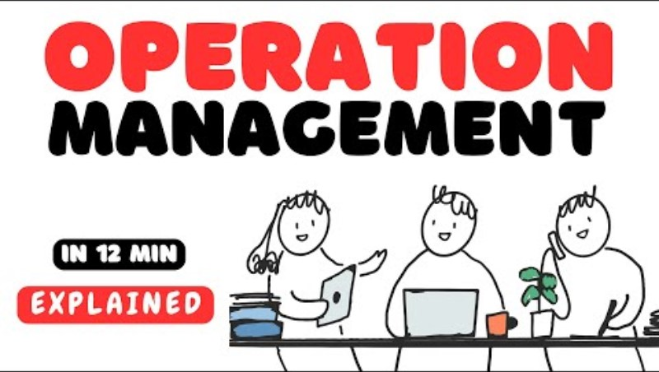
Be inspired by..
A brief video introducing the basics of operations management, including the role of operations managers, the importance of resource allocation, and the relationship between operations and business strategy.
Key Learning Points:
Operations as a core function in every business.
How managing operations drives efficiency & scalability.
The importance of aligning operations with strategy.
External Link
Reflection Question: What could be applied to you?

Slide 18
Tool: Bringing It All Together with Lean Model
Expanding Your Network
The Lean Model is a methodology focused on maximizing value for the customer while minimizing waste (of resources and time).
It originated from the Toyota Production System and is now widely used across various industries to improve operational efficiency.
This methodology is highly recommended as a way of thinking about operations for moderate structures, startups and small businesses, especially launched in contexts similar to those facing underrepresented entrepreneurs.
Rethink your operational model accordingly!
More on the next slide…
Value
Continuous Improvement
Value
Stream
Financial
Resources
Pull
System
Flow
Ease
Material
Resources

Slide 19
Lean Model Key Principles
Value: Identify what your customers truly value and ensure your business operations focus on delivering that value.
Value Stream: Map out every step in your process (the "value stream") and identify which steps add value to the customer and which do not.
Flow: Ensure smooth, uninterrupted workflows by eliminating bottlenecks and reducing delays between processes.
Pull System: Implement a pull-based system where work is only initiated when there is demand, preventing overproduction.
Continuous Improvement (Kaizen): Lean is built on the foundation of Kaizen, or continuous, incremental improvements in all areas of your business.

Slide 20
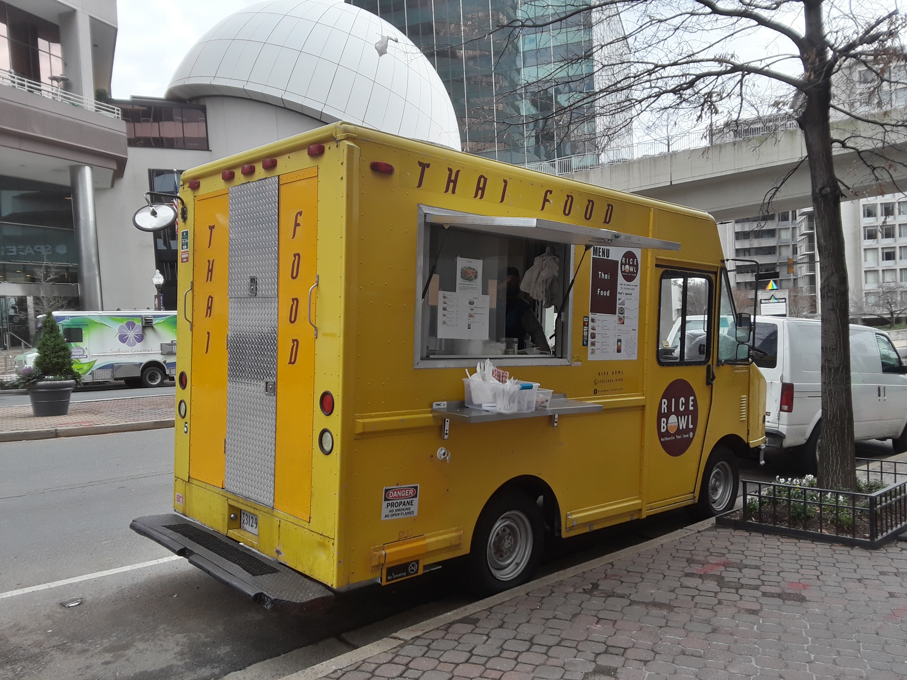
Example
Scenario: A small food delivery startup struggled with operational inefficiencies due to poor resource allocation and lack of a structured supply chain.
Key Challenges:
  Overstaffing during low-demand periods and understaffing during peak times.
  Inventory mismanagement = waste.
  Lack of automation = delays in orders.
Outcome: The company implemented lean operations, optimized its supply chain, and automated order processes.
These changes impacted operations and are expected to improve profitability and scalability.

Slide 21
The Importance of Resource Allocation
Resource Allocation is the process of distributing available resources in the most efficient way to meet business objectives & generate growth or revenue.
In startup management, resource allocation or resource management is the scheduling of activities and the resources required by those activities while taking into consideration both the resource availability and the project time.
Startups typically have limited capital and personnel, so making strategic decisions on where to allocate resources can make or break the business.
Key Factors:
  Prioritizing activities that generate value.
  Balancing innovation with operational needs.
  Aligning resources with strategic goals.

Slide 22
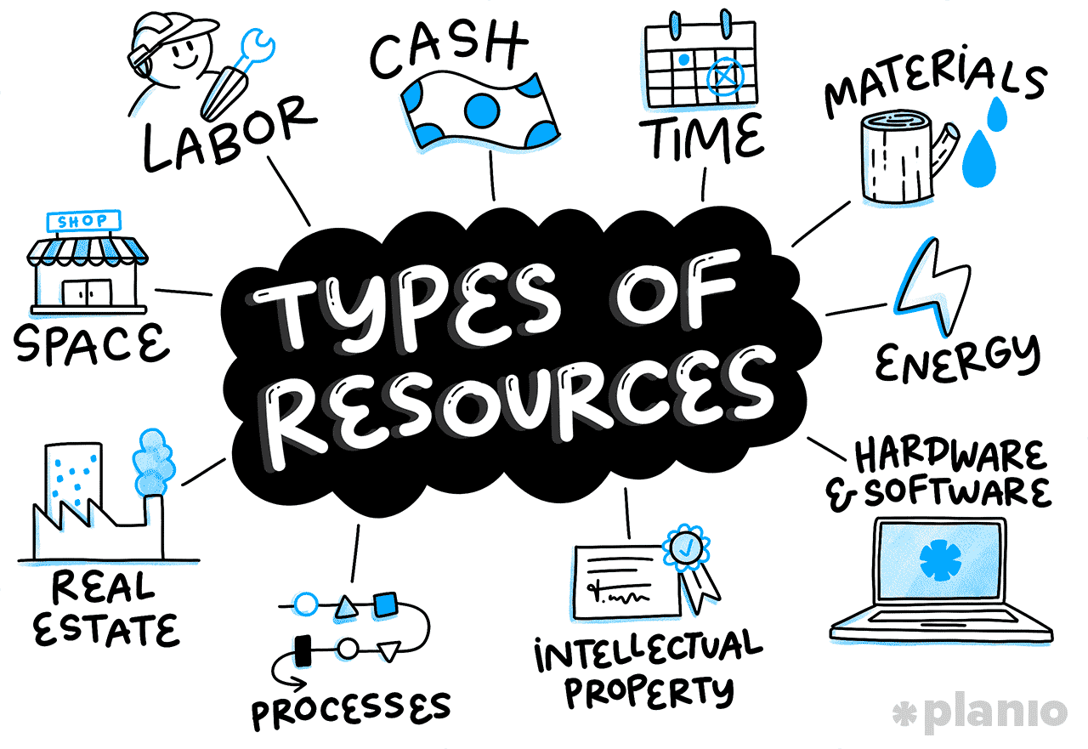
Tool: What is a Resource Allocation Matrix
Expanding Your Network
A visual tool to help businesses see where resources (time, money, personnel) are being invested and identify areas of inefficiency or over-allocation.
How to Use It:
  Create a grid with resources on one axis and business functions (e.g., marketing, production) on the other.
  Assign percentages or values to indicate how much of each resource is allocated to each function.
  Benefits: Helps ensure resources are aligned with business priorities and that the most critical areas are getting adequate support.

Slide 23

Tool: Resource Allocation Matrix - Example
Expanding Your Network
Which category
Total availability of the resource within the company or for this project
How much of the total resource will be used per quarter / month / etc.
The resource and what it is for
Resource Name | Category | Total Cost | Q1 | Q2 | Q3 | Q4
Person’s Name | HR | 20,000 Euros | 10% | 20% | 10%
Production | Material | 50,000 Euros | 25% | 15%
Operations & Meetings | Time | 300 Hours | 20% | 10% | 10% | 10%
Stocking | Store Space | 200 M2 |  |  | 50%
Example of Resources Allocation Matrix for a project to be executed over 4 quarters, with percentages of allocation from the total available pool of resources.

Slide 24

Be inspired by..
A practical video explaining techniques for optimizing resource allocation in small businesses. The video covers real-world examples of startups that succeeded through effective resource management.
Key Learning Points:
  Identifying high-priority areas for optimization.
  Using data to inform resource allocation decisions.
  Balancing short-term needs with long-term goals.
External Link
Reflection: How does that apply to your business?

Slide 25

Activity : Using Resources Optimally
Expanding Your Network
In this interactive game, learners are given a fictional startup scenario (ex: build a village) with a limited budget and workforce. They must allocate resources to various business areas (marketing, production, HR) to achieve specific goals such as increasing sales or improving efficiency.
Learners will use a digital tool or printed sheets to assign points (representing resources) to different areas of the business. At the end of the game, they will compare their results to see how their decisions affected the overall success of the project.
Learning Objective: To help learners understand the trade-offs and strategic decisions involved in resource allocation, especially in a resource-constrained environment like a startup.

Slide 26
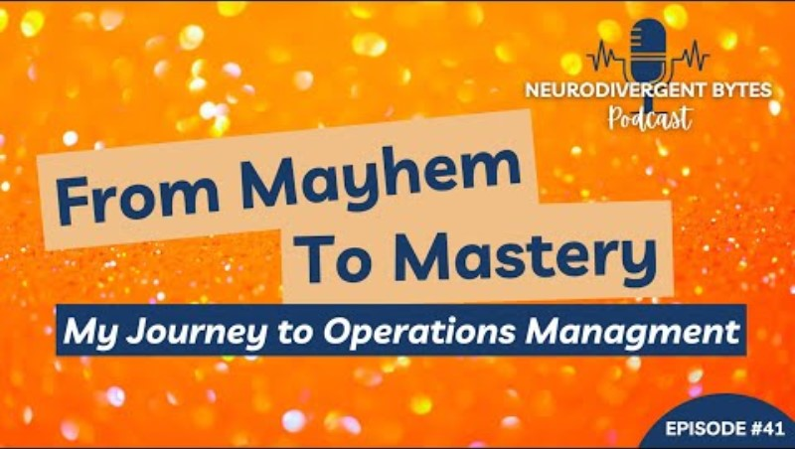
Be inspired by..
Many neurodivergent founders feel that they belong to the under-represented entrepreneur’s category.
Meet Karalee who shares insights about she managed to streamline her operations and master the game of operational management after a period of mayhem.
Reflection: Embark on this journey of discovery and learn how to build the most adapted model which would work best for your business.
External Link

Slide 27


Key Takeaways
Optimal use of Resources
1
Operations management is crucial for growing and scaling a business efficiently.
Maximizing Value
2
Effective resource management maximises output with limited inputs.
Marinating Relationships
3
Small businesses must be strategic in their allocation of human, financial, and material resources.

Slide 28

Operations Management by William J. Stevenson: A comprehensive guide to the principles of operations management, including resource allocation, and more.
The Goal: A Process of Ongoing Improvement by Eliyahu M. Goldratt: A foundation on identifying bottlenecks and improving operational efficiency.
Operations Management for Competitive Advantage by Richard Chase, F. Robert Jacobs, and Nicholas Aquilano: with focus on strategy.
Further Reading

Slide 29
02
Supply Chain Management and Optimization

Slide 30

In the digital age,
your supply chain can either be a liability
or your greatest asset.
Marc Benioff,
CEO of Salesforce

Slide 31
Core Components of an Efficient Supply Chain
Supplier Selection: The process of finding and partnering with reliable suppliers who provide high-quality materials at competitive prices.
Relationship Management: Establishing long-term, mutually beneficial relationships with suppliers and stakeholders is crucial for consistent supply and negotiation power.
Logistics: Managing the movement of goods from suppliers to your business and eventually to your customers. Efficient logistics reduce costs and improve delivery times.
Distribution: Involves the delivery of finished goods to customers. Effective distribution networks ensure that products reach the end user efficiently and on time.

Slide 32
Common SCM Challenges for Small Businesses
Limited Capital: Small businesses, especially in context of under-represented entrepreneurs often lack the financial resources to invest in advanced SCM systems or hold large inventories, leading to stockouts or delays.
Risk Management: External risks, such as natural disasters, political instability, or market volatility, especially for vulnerable groups can disrupt the supply chain and its stability.
Supplier Negotiation: Small businesses may have limited negotiation power with suppliers due to order volumes, leading to higher costs. This is amplified by the lack of market knowledge in the case of the underrepresented.
Technology Integration: Many small businesses struggle with adopting SCM technologies such as inventory management software, which could enhance efficiency.

Slide 33
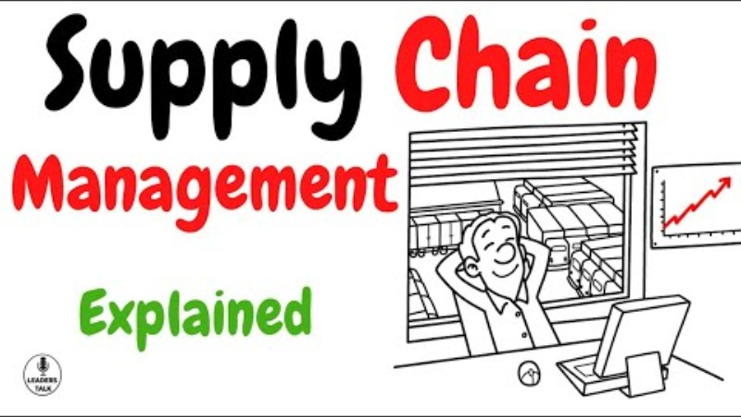
Be inspired by..
This video explains the basic principles of supply chain management, from sourcing materials to delivering products to customers. It covers key components such as procurement, logistics, and distribution, and illustrates how they interact to ensure business efficiency.
Key Learning Points:
The role of SCM in reducing operational costs.
How effective logistics and distribution improve customer satisfaction.
The importance of building strong relationships with suppliers.
External Link

Slide 34

Example
A small organic skincare brand was facing supply chain inefficiencies. The business dealt with long lead times from suppliers, frequent stockouts, and poor communication across.
Challenges: Delayed raw material shipments led to production bottlenecks, and inefficient inventory tracking caused stockouts during peak demand periods.
Solution: The business adopted an SCM software to track inventory levels in real time, and the owner negotiated better terms with suppliers for faster lead times and adopted JIT (Just-in-Time) practices.

Slide 35
Tools for Supply Chain Optimization
Supply Chain Optimization Framework: A tool to assess each component of the supply chain, identify inefficiencies, and develop strategies to enhance performance.
Vendor Scorecards: These track supplier performance across metrics like quality, delivery times, and pricing. By consistently measuring performance, businesses can make informed decisions about which suppliers to continue working with.
SCM Software: Introduce low-cost SCM tools suitable for small businesses, such as inventory management software (e.g., TradeGecko, Fishbowl). These systems automate ordering processes, track inventory in real time, and provide data insights to make informed supply chain decisions.

Slide 36
Tool: Supply Chain Optimization Framework - Example
Expanding Your Network
Component | Key Metrics to Evaluate | Current Performance | Identified Inefficiencies | Optimization Strategies | Target Outcome
Supplier Management | - Supplier reliability - Delivery lead time - Cost of goods | Supplier X delivers 80% on-time Cost is above industry average | Late deliveries causing stockouts Higher costs | - Negotiate better terms - Consider alternative suppliers - Create backup supplier list | Increase on-time deliveries to 95% Reduce supplier costs by 10%
Logistics Efficiency | - Transportation cost - Freight time - Risk management | High transportation costs Average freight time: 7 days | Delays during peak season High shipping costs during demand spikes | - Consolidate shipments - Partner with cost-effective logistics providers | Reduce transportation costs by 15% Decrease average freight time to 5 days
Inventory Management | - Inventory turnover ratio - Stockout frequency - Holding costs | Low turnover ratio Frequent stockouts High storage costs | Excess inventory of low-demand items Stockouts on high-demand products | - Implement Just-In-Time (JIT) - Use demand forecasting tools | Improve turnover ratio by 25% Decrease stockout occurrences by 50%
Distribution Channels | - Order fulfillment time - Customer satisfaction - Distribution costs | 72% of orders fulfilled on time Mixed customer satisfaction | Fulfillment delays Customer complaints about slow delivery | - Automate order processing - Partner with 3PL (third-party logistics) | Improve fulfillment to 90% on-time Increase customer satisfaction by 20%
Risk Mitigation | - Supplier risk index - Contingency plans - Flexibility of operations | Limited supplier diversity No backup suppliers | High dependency on one supplier No risk mitigation strategy | - Diversify supplier base - Develop contingency plans for key suppliers | Reduce supplier risk by 30% Establish backup suppliers

Slide 37
How to Use : Supply Chain Optimization Framework
Expanding Your Network
Evaluate Each Component: For each aspect of your supply chain (supplier management, logistics, etc.), assess the key metrics listed in the table.
Identify Inefficiencies: Determine where the supply chain is underperforming (e.g., delays, higher costs, stockouts).
Apply Optimization Strategies: Implement the recommended strategies for improvement (e.g., renegotiating terms with suppliers, consolidating shipments, or adopting inventory management software).
Set Target Outcomes: Define measurable goals for each optimization strategy (e.g., reducing transportation costs by 15%, improving order fulfillment rates by 90%).
This tool will help you systematically analyze and enhance your supply chain, ensuring that it operates at peak efficiency, cost-effectiveness, and reliability.

Slide 38
Strategies for Supply Chain Risk Mitigation
Diversification:
Reduce risk by sourcing materials from multiple suppliers across different regions. This reduces dependence on a single supplier and mitigates the impact of disruptions.
Contingency Planning:
Prepare for potential supply chain disruptions by developing a backup plan. This could involve having alternative suppliers or holding safety stock to prevent stockouts.
Technology Integration:
Use technology like SCM software to monitor supplier performance and track shipments in real time. This ensures early identification of potential disruptions.

Slide 39
Supply Chain Optimization for Scaling Businesses
As small businesses grow, their supply chains must scale accordingly. Scaling requires adapting logistics, expanding the supplier network, and increasing production capacity while maintaining efficiency and quality.
Strategies:
Supplier Network Expansion: Partner with additional suppliers to ensure raw materials can meet increased demand.
Automation: Implement automated systems for inventory management and logistics coordination.
Third-Party Logistics (3PL): Outsourcing logistics to specialised providers allows businesses to handle larger order volumes without investing heavily in infrastructure.

Slide 40

Activity : Supply Chain Puzzle Game (1)
Expanding Your Network
Preparation Phase:
Suggest a scenario for a fictive or real business.
Design multiple cards that contain variables related to the business’ Supply Chain, proposing different values to each of the variables (e.g., Supplier A is fast & costly, Supplier B is slower but cheaper, Supplier C… Suggestions on following pages)
Assign a score for each of the cards, based on potential customer satisfaction and value obtained from choices.

Slide 41
Activity : Supply Chain Puzzle Game (2)
Expanding Your Network
Playing the Game:
  Divide participants in two competing teams. Each round participants will get one move to consult and choose a variable card from each category.
  By the end of the game, winner is decided on total assigned scores and ratings from the back of the cards.
  Reflect: Define basic supply chain elements like sourcing and logistics / Practise budgeting and decision-making to optimise supply chain performance / Analyse the answers.

Slide 42
Supply Chain Puzzle Game – Card Suggestions
Expanding Your Network
Supplier (6 Cards):
Local Artisan Supplier
Cost: Medium | Speed: Fast |
Quality: High
Rating: ★★★★☆
Overseas Manufacturer
Cost: Low | Speed: Slow |
Quality: Medium
Rating: ★★☆☆☆
Premium Materials Supplier
Cost: High | Speed: Medium |
Quality: V. High
Rating: ★★★★☆
Bulk Supplier (Discount)
Cost: V. Low | Speed: Medium | Quality: Low
Rating: ★★☆☆☆
Recycled Materials Supplier
Cost: Medium | Speed: Slow | Quality: Medium
Rating: ★★★☆☆
On-Demand Supplier
Cost: High | Speed: Very Fast | Quality: High
Rating: ★★★★☆
Production (6 Cards):
In-House Production
Cost: Medium | Speed: Fast | Quality: High
Rating: ★★★★☆
Third-Party Manufacturer
Cost: Low | Speed: Slow | Quality: Medium
Rating: ★★★☆☆
Automated Production Line
Cost: High | Speed: Very Fast | Quality: Consistent
Rating: ★★★★★
Local Workshop
Cost: High | Speed: Medium | Quality: High
Rating: ★★★★☆
Freelance Craftsperson
Cost: Medium | Speed: Slow | Quality: High
Rating: ★★★☆☆
Lean Manufacturing System
Cost: Medium | Speed: Fast | Quality: High
Rating: ★★★★☆
Logistics (6 Cards):
Express Courier Service
Cost: High | Speed: Very Fast | Quality: Reliable
Rating: ★★★★★
Standard Shipping Service
Cost: Medium | Speed: Medium | Quality: Consistent
Rating: ★★★★☆
Economical Shipping
Cost: Low | Speed: Slow | Quality: Average
Rating: ★★★☆☆
Dedicated Delivery Fleet
Cost: High | Speed: Fast | Quality: Reliable
Rating: ★★★★☆
Shared Delivery Network
Cost: Low | Speed: Medium | Quality: Inconsistent
Rating: ★★☆☆☆
Drop Shipping
Cost: Low | Speed: Slow | Quality: Varies
Rating: ★★★☆☆
Inventory (6 Cards):
Just-In-Time Inventory
Cost: Low | Speed: Fast | Quality: Requires Precision
Rating: ★★★★☆
Bulk Inventory
Cost: Medium | Speed: Fast | Quality: High
Rating: ★★★★☆
Safety Stock Management
Cost: Medium | Speed: Slow | Quality: High Reliability
Rating: ★★★★☆
Automated Inventory System Cost: High | Speed: Very Fast | Quality: Consistent
Rating: ★★★★★
Manual Inventory Tracking
Cost: Low | Speed: Slow | Quality: Error-Prone
Rating: ★★☆☆☆
Outsourced Inventory
Cost: Medium | Speed: Medium | Quality: Dependable
Rating: ★★★★☆
Distribution (6 Cards):
Direct-to-Customer Shipping
Cost: Medium | Speed: Fast | Quality: Reliable
Rating: ★★★★☆
Third-Party Logistics (3PL)
Cost: High | Speed: Fast | Quality: High
Rating: ★★★★★
Local Retail Distribution
Cost: Medium | Speed: Medium | Quality: Consistent
Rating: ★★★★☆
Wholesale Distributor
Cost: Low | Speed: Medium | Quality: Average
Rating: ★★★☆☆
E-Commerce Fulfillment
Cost: Low | Speed: Fast | Quality: Dependable
Rating: ★★★★☆
Pop-Up Store Distribution
Cost: Low | Speed: Slow | Quality: Inconsistent
Rating: ★★★☆☆
Risk Mitigation (6 Cards):
Diversified Suppliers
Cost: Medium | Speed: Medium | Quality: Balanced
Rating: ★★★★☆
Backup Supplier Contracts
Cost: High | Speed: Fast | Quality: High
Rating: ★★★★★
Contingency Inventory
Cost: High | Speed: Medium | Quality: Dependable
Rating: ★★★★☆
Third-Party Logistics
Cost: High | Speed: Fast | Quality: Highly Reliable
Rating: ★★★★★
Local Suppliers (Backup)
Cost: Medium | Speed: Slow | Quality: Average
Rating: ★★★☆☆
Emergency Inventory Stock
Cost: Medium | Speed: Medium | Quality: Reliable
Rating: ★★★★☆

Slide 43
Role of Inventory Management
Inventory Management ensures the right products are available at the right time to meet demand while minimizing costs. Balancing supply & demand is critical to avoid overstocking (which increases costs) and stockouts (which lead to lost sales). Effective stock management supports overall operational efficiency and customer satisfaction.
Based on that, the most important key points to guarantee optimised results are:
Cost Efficiency: Avoiding excess inventory reduces storage costs and waste.
Stock Availability: Ensuring timely replenishment prevents stockouts and enhances customer service.
Impact on Cash Flow: Proper inventory management ensures better liquidity by avoiding overinvestment in unsold stock.

Slide 44
Techniques for Inventory Optimization
Economic Order Quantity (EOQ):
A formula that calculates the optimal order quantity to minimise total inventory costs, balancing order frequency with holding costs.
Ensures you are ordering the right amount to meet demand without overstocking.
Demand Forecasting:
Predicting future customer demand to plan inventory orders accurately.
Essential for both JIT and EOQ to ensure balance between supply and demand.
Just-In-Time (JIT):
Inventory is ordered and received only when needed for production or sales.
Reduces storage costs but requires accurate demand forecasting.

Slide 45
Inventory Control & Order Fulfillment Strategies
Efficient Order Fulfillment: Ensuring orders are processed and delivered quickly and accurately to maintain customer satisfaction.
Automation: Using inventory management software to track stock levels, automate reorders, and predict demand.
Safety Stock: Keeping a small buffer of extra inventory to prevent stockouts during unforeseen demand spikes. And regularly counting inventory to ensure accuracy and avoid discrepancies.
ABC Analysis: Prioritizing high-value inventory (A items) for more frequent monitoring while using less effort for lower-value items (B&C).

Slide 46

Key Takeaways
Full Cycle Efficiency
1
Supply chain management is critical for ensuring the efficient movement of goods from suppliers to customers.
Optimisation is Crucial for Entrepreneurs
2
Small businesses must overcome challenges such as limited capital, supplier negotiation power, and risk management to optimise their supply chains.
Scaling SCM Needs Strategic Foresight
3
Scaling a supply chain involves expanding supplier networks, automating processes, and potentially outsourcing logistics to handle increased order volumes.

Slide 47

Being underestimated is the biggest competitive advantage you can have.
Sara Blakely,
Founder of Spanx

Slide 48

Bonus Inspiration: Bringing it all together
Marielle, sharing her story exclusively with MOSAIC founders, is a French-Lebanese founder, who built a project for a niche market.
Her background, and the background of her project, especially in terms of working in multiple countries, make her business model unique within the market.
In this video, Marielle talks about how she designed her adaptive model of operations management, covering the very specific needs of her project, taking into consideration the limited resources and the complex supply chain.
External Link

Slide 49
Logistics and Supply Chain Management by Martin Christopher: Offers strategies to design and implement efficient and cost-effective supply chains with a focus on creating value through logistics.
Supply Chain Management: Strategy, Planning, and Operation by Sunil Chopra: Provides a strategic overview of supply chain design, planning, and operations with practical tools.
The Supply Chain Revolution: Innovative Sourcing and Logistics for a Fiercely Competitive World by Suman Sarkar:
Focuses on leveraging innovative supply chain strategies for small businesses to stay competitive in a dynamic global environment.
Further Reading

Slide 50
03
Advanced
Operational Efficiency and Scalability Strategies

Slide 51

Diverse teams outperform homogenous ones. Entrepreneurs who embrace diversity create scalable innovative solutions.
McKinsey & Company

Slide 52
Operational Efficiency and Scalability
Operational Efficiency refers to optimizing processes, resources, and workflows to reduce waste and improve performance. Efficient operations help businesses lower costs, improve quality, and increase productivity.
Scalability is the ability of a business to grow and handle increased demand without sacrificing performance or quality. Scalable businesses can expand operations smoothly through process improvements and technology.
Small businesses need to build efficient systems early to ensure they can scale when demand grows. This requires implementing lean methodologies and scalable operations to support continuous and long-term growth.

Slide 53
Lean and Six Sigma: Principles for Efficiency
Lean Methodology: Focuses on creating value for the customer by minimizing waste in business processes. The core principles include identifying waste, optimizing flow, and continuous improvement.
Six Sigma: A data-driven approach to reducing defects and improving quality.
Six Sigma uses the DMAIC (Define, Measure, Analyze, Improve, Control) methodology to optimise processes.
Combining Lean and Six Sigma: Lean focuses on efficiency, while Six Sigma improves quality by reducing variability. Together, they create a framework for maximizing operational performance.
Be mindful. Consider …
types of waste consist of overproduction, waiting, excess inventory, defects, unnecessary motion, over-processing, and underutilised talent.

Slide 54
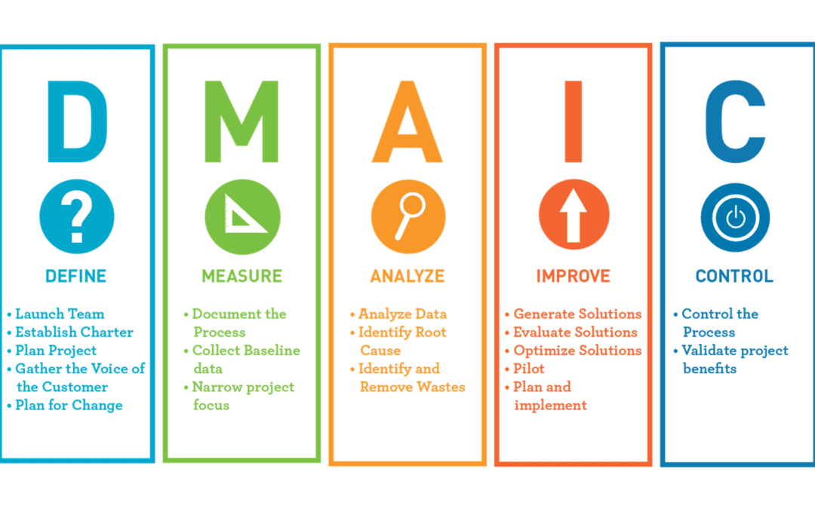
Six Sigma’s DMAIC method
Even if not fully applicable for small businesses, the DMAIC methodology is a highly recommended framework to meditate upon to increase efficiency.

Slide 55
Tool: Lean Process Mapping
Expanding Your Network
Lean Process Mapping is a tool used to visualise the steps involved in a process to identify inefficiencies, bottlenecks, and areas of waste. It helps businesses streamline operations and improve workflow, considering the following steps:
  Identify the process to be mapped.
  Break down each step in the process.
  Categorise each step as value-adding or non-value-adding.
  Identify inefficiencies (e.g., delays, redundancies).
  Redesign the process to eliminate waste and optimise flow.
Benefits: Provides a clear view of where improvements can be made, promotes better team communication, and creates a foundation for continuous improvement.
Visual or tabular formats can be used. Please see example on the next slide.

Slide 56
Example: Lean Process Mapping (1)
Expanding Your Network
Explanations on the next page
Process / Step | Step Description | Time (mins) | Responsible Person /Team | Waste Identified? | Type of Waste | Suggested Improvement | Status of Improvement
Step 1 | Receive Order | 5 | Sales Team | Yes | Waiting | Automate order capture with CRM | In Progress
Step 2 | Process Payment | 3 | Finance Team | No | N/A | None | N/A
Step 3 | Check Inventory | 10 | Warehouse | Yes | Overprocessing | Integrate inventory with order system | Completed
Step 4 | Pack Product | 15 | Fulfillment Team | No | N/A | Standardise packaging size | Planned
Step 5 | Ship Product | 20 | Shipping Team | Yes | Waiting | Partner with faster shipping provider | Pending
Step 6 | Confirm Delivery | 2 | Sales Team | No | N/A | Automate confirmation email | Completed

Slide 57

Example: Lean Process Mapping (2)
Expanding Your Network
Process Step: The specific step or activity in the workflow being analyzed (e.g., "Receive Order," "Ship Product").
Step Description: A short explanation of what happens during that process step.
Time (mins): The time it takes to complete that process step, measured in minutes (or relevant time unit).
Responsible Person/Team: The individual or team accountable for executing the step (e.g., Sales Team, Fulfillment Team).
Waste Identified (Y/N): Indicates whether waste (inefficiency) is present in this step. Answer with "Yes" or "No."

Slide 58
Example: Lean Process Mapping (3)
Expanding Your Network
Type of Waste: If waste is identified, specify the type (e.g., Waiting, Overproduction, Motion, Defects).
Suggested Improvement: Propose actions to reduce waste or improve efficiency in the process step.
Status of Improvement: The current status of implementing the improvement (e.g., "Completed," "In Progress," "Planned")
Reproducing similar tables in Excel or Google Sheets with conditional formatting would make the tool more visually interactive

Slide 59
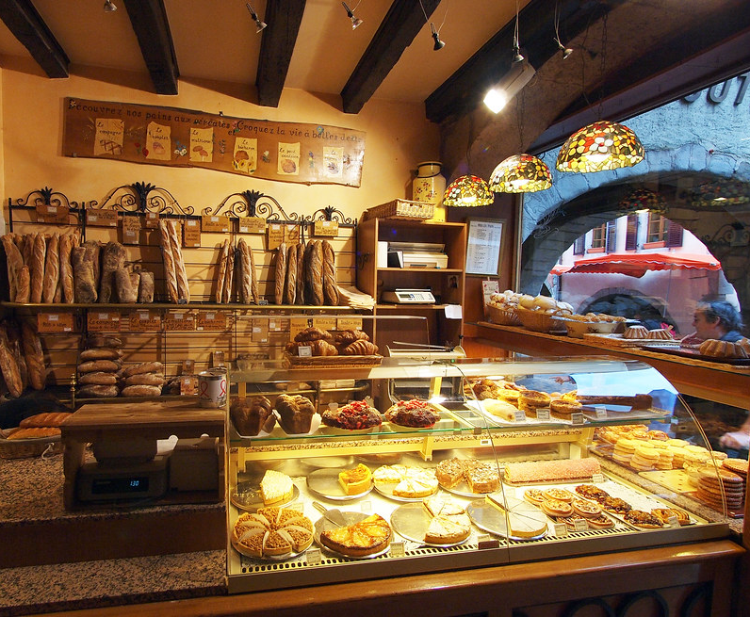
Example
A small bakery was struggling with inefficient production processes, leading to frequent delays and high operational costs.
Challenges:
Overproduction = food waste +storage costs.
Poor workflow = delays in fulfilling orders.
Lean Implementation : Used lean principles to reorganize the workspace to reduce unnecessary movement and introduced Just-In-Time (JIT) inventory practices with visual tools to track production to minimise waste.
Outcome -15% operational costs, +20% on-time delivery, and -30% food waste.
This Photo by Unknown Author is licensed under CC BY

Slide 60

Be Inspired by..
This video explains the basic principles of Lean and Six Sigma, focusing on how small businesses can implement these strategies to improve operational efficiency. It provides real-life examples of businesses that reduced waste and improved quality using these methodologies.
Key Learning Points:
How to identify waste in business processes.
Steps to implement the DMAIC methodology to reduce variability and improve quality.
External Link

Slide 61
Other Tools & Tactics for Lean
Lean Process Mapping Templates: Visual tools that allow businesses to map out their workflows and identify areas for improvement. These templates help teams visualise each step in the process, categorise tasks, and pinpoint bottlenecks.
Pareto Chart: A Six Sigma tool that helps businesses identify the most significant causes of defects or inefficiencies by focusing on the 20% of factors causing 80% of problems (Pareto Principle).
Kanban System: A visual management tool that tracks the flow of tasks through a process, making it easier to manage workflows and ensure tasks are completed efficiently.

Slide 62
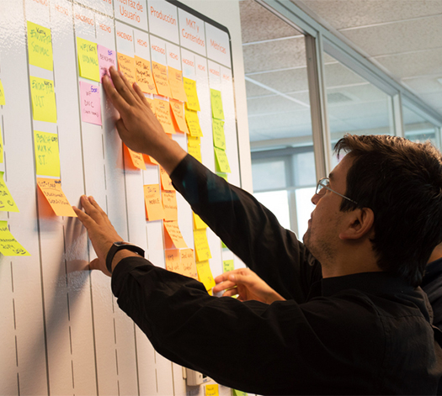
Activity : Using Resources Optimally
Expanding Your Network
Participants will work in teams to create a Kanban board for a fictional business process, organizing tasks into stages (To Do, In Progress, Done). They will identify bottlenecks and suggest improvements to optimise workflow.
Learning Outcome: By the end, participants will understand how to create and use a Kanban board, identify inefficiencies, and improve task flow.
Instructions:
Collectively write down tasks related to a process on post-its.
Arrange on a Kanban board (To Do, In Progress, Done).
Analyse the workflow to find inefficiencies.
Propose improvements to enhance flow.
Present findings and suggested changes. Discuss the process!

Slide 63
Scalability Strategies for the Underrepresented
Due to the limitation of accessibility and inclusivity facing the underrepresented entrepreneurs, scalability requires masterful maneuvering of the limited resources.
Lean Operations
Collaborative Networks
Alternative Funding
Affordable Technology
Cultural Sensitivity
Start with minimal viable products (MVPs) to test markets with minimal investment & operations
Utilise community incubators,, and minority-owned networks to share resources and reduce costs.
Explore non-traditional financing like microloans, crowdfunding, impact investors, and grants.
Use affordable tech tools, cloud solutions, and open-source platforms to minimise costs while ensuring scalability.
Focus on products that reflect cultural values and diversity to attract socially conscious clients

Slide 64
Scaling Operations for Growth
Scalability refers to the ability of a business to grow its operations (and its sales) without being hindered by limited resources or inefficient processes.
Key Strategies for Scaling are:
Standardization: Establish standard operating procedures (SOPs) to ensure consistent quality and performance as the business grows.
Automation: Automating repetitive tasks (e.g. customer service) allows businesses to handle increased demand without overwhelming the workforce.
Outsourcing: Leveraging 3rd party providers for non-core activities (e.g. logistics, IT services) can free up resources, allowing businesses to scale growth
Maintaining Efficiency: As businesses scale, maintaining operational efficiency becomes more challenging. Continuous process improvements, regular reviews, and adopting scalable technology are critical.

Slide 65
Leveraging Automation and Technology for Growth
As businesses grow, manual processes can become bottlenecks that limit scalability. Automation helps streamline operations, reduce errors, and handle higher volumes of work without increasing costs. Cloud-based tools and software-as-a-service (SaaS) options are ideal for this. Areas for automation could include:
Inventory Management: Automated systems can track stock levels in real-time, generate orders when inventory is low, and prevent overstocking.
Customer Relationship Management (CRM): To manage customer data, sales pipelines, and communication, improve customer service.
Production, Marketing & Reporting: In these processes, automation can increase output and reduce the need for manual labor, improving efficiency and quality control.

Slide 66

Example
Due to manual processes, small e-commerce company faced delivery & customer satisfaction challenges with growing orders. Challenges:
Inaccurate inventory tracking = stockouts and delays.
Customer support was overwhelmed due to increased enquiries = slow responses
Solution & Outcome: The company implemented an automated inventory management system for real-time stock updates and automatic reordering. It adopted a CRM system to handle inquiries and automate communication. This contributed to 72% process efficiency improvement,

Slide 67
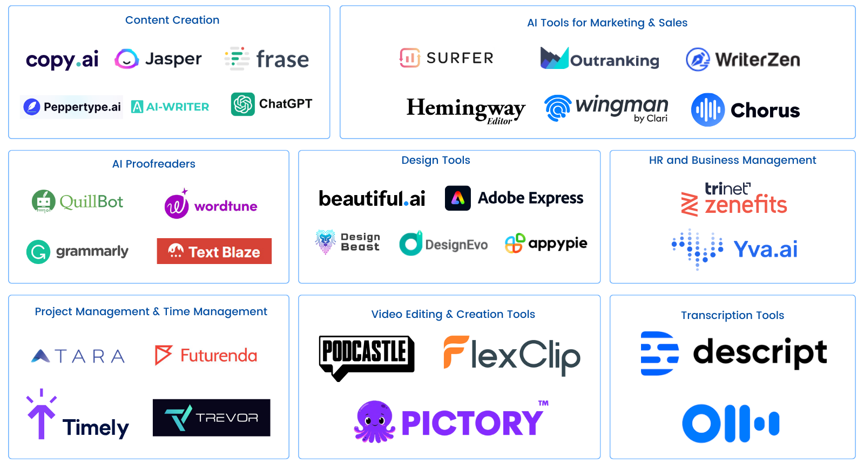
Recommended AI-supported Tools to Help Scalability

Slide 68
Tool: PDCA Cycle
Expanding Your Network
Managing operations and processes at all stages (launching, sustainability, scalability) require a minimum knowledge of project management principles. PDCA Cycle tool helps entrepreneurs keep an eye on the state of each process and procedure, to know its current and desired states.
PLAN
DO
Process Name & Description
Identify the problem and develop a strategy for improvement.
Test the strategy on a small scale or in a pilot project.
CHECK
ACT
Review the results and analyze data.
Implement success strategy or adjust it for the next cycle.

Slide 69

Revenue is vanity,
profit is sanity,
but cash is king.
Alan Miltz

Slide 70
Budgeting and Cost Control
Budgeting and cost control in operations involves planning, organizing, forecasting, controlling, and monitoring financial resources to achieve operational objectives.
Effective financial management ensures that businesses use their limited financial resources efficiently to grow and scale. Without proper financial oversight, small businesses can quickly run into cash flow issues that threaten their survival. Many financial management tools are explained in MOSAIC’s financial modules. Our section tackles only the link between operations and finance.
Key Areas of Focus: Budgeting, forecasting, cost control, and financial literacy are key to successful financial management in small businesses, allowing them to improve operational efficiency while preparing for growth.

Slide 71
Budgeting for Operations
An operational budget is a detailed projection of revenue and expenses over a specific period, helping businesses allocate resources effectively.
The main important concepts of operational budgeting include:
  CAPEX (Capital Expenditure): Long-term investments in assets such as equipment, machinery, or property. These investments help businesses scale but require significant upfront costs.
  OPEX (Operational Expenditure): Day-to-day expenses required to run the business, such as rent, utilities, and salaries. These costs must be carefully managed to avoid overspending.
  Budgeting: Establishing clear goals, estimating expenses and revenues, and continually review and adjust the budget as the business evolves.

Slide 72
Forecasting for Small Businesses
Financial Forecasting involves predicting future revenues, expenses, and cash flow based on historical data (or data from similar businesses), market trends, and business goals. It helps businesses plan for growth and navigate uncertainties.
Cash Flow Management is the mechanism used for monitoring cash inflow and outflow to ensure that the business has enough liquidity to meet its obligations. Without proper cash management, even profitable businesses can run into trouble. Optimizing cash management is done through forecasting.
Simple Forecasting Techniques:
  Use past performance to predict future trends.
  Use Market analysis + customer demand forecasts to refine projections.
  Continually adjust forecasts as new information becomes available.

Slide 73

Example
A small tech startup struggled with managing its cash due to underestimating expenses. This led to missed payments and delayed operations.
Challenges:
Unexpected overhead costs = strain.
Lack of clear distinction between CAPEX and OPEX = confusion in spending.
Solution and Outcome: The startup adopted a robust budgeting process, distinguishing between CAPEX and OPEX, and implemented monthly financial forecasting. It also prioritised essential expenses and delayed non-critical investments until cash flow improved.

Slide 74

Be inspired by..
Forecasting is the toughest part of startup finance for entrepreneurs, especially for complex contexts.
Learning how to forecast and budget are critical. The point is not to try to predict the future, but to build a financial model that can be improved over time.
Key Learning Points:
The purpose of five-year projections?
What will investors want to know about these projections? How realistic are they?
What are the assumptions underlying projections?
External Link
Explore much more in MOSAIC’s other Financial Modules

Slide 75
Operational Tools for Financial Planning
Budgeting Templates: Introduce customizable Excel templates to help small businesses create operational budgets. These templates allow for clear delineation between CAPEX and OPEX, making it easier to track spending.
Financial Forecasting Tools: Tools like QuickBooks, Xero, and Wave can be used to automate cash flow management, predict future trends, and simplify financial reporting.
Benefits of Digital Tools:
  Automating the budgeting process reduces the risk of human error.
  Financial tools provide real-time insights that can inform decision-making and resource allocation.

Slide 76

Activity : Simulate an Automated Day
Expanding Your Network
In teams, participants assume different roles within a startup (Marketing, Production, Sales, Operations, Finance, etc.). They are tasked with finding automation tools to streamline processes within their assigned functions, to simulate a workday using the tools and discuss the outcomes.
Instructions:
Assign roles to participants (full organizational structure).
Each participant researches automation tools for their function.
Simulate a workday using the selected tools to automate tasks.
Discuss results as a team, focusing on tool effectiveness and workflow improvements.
Present findings and recommendations.
Share with the other groups and receive feedback.

Slide 77

Key Takeaways
Less Waste = Higher Efficiency
1
Lean and Six Sigma methodologies are powerful tools to improve operational efficiency by reducing waste & defects.
Standardization and Automation are Key
2
Scaling a business requires the standardization of processes, automation, and the use of technology to handle increased demand and better manage systems.
Financial Operations are the Magic Link
3
Continuous process improvement and regular reviews vis-à-vis the strategic financial projection are essential for maintaining efficiency during growth.

Slide 78
The Lean Startup: How Today's Entrepreneurs Use Continuous Innovation to Create Radically Successful Businesses by Eric Ries: A must-read for entrepreneurs looking to scale their businesses by applying lean methodologies for growth and continuous innovation.
Scaling Up: How a Few Companies Make It...and Why the Rest Don’t by Verne Harnish: A step-by-step guide on how to scale businesses sustainably by mastering four key areas: people, strategy, execution, and cash.
The Toyota Way: 14 Management Principles from the World's Greatest Manufacturer by Jeffrey Liker: Offers deep insights into Toyota’s lean manufacturing principles and how they can be applied to scale operations efficiently.
Further Reading

Slide 79
04
Quality Management and Continuous Improvement

Slide 80

Continuous improvement
is better than
delayed perfection
Mark Twain

Slide 81
Understanding Quality Operations
Performance Measurement: The systematic process of assessing how well business operations are being executed.
Continuous Improvement: A business strategy to enhance processes over time, focusing on small, incremental changes that improve efficiency and quality.
These two concepts rely heavily on the following key concepts:
KPIs (Key Performance Indicators): Metrics used to evaluate how well a business is meeting its operational goals.
Benchmarking: Comparing your business processes and performance metrics to industry standards or best practices.
Quality Enhancement: Implementing methodologies like Total Quality Management (TQM) and Kaizen to drive operational enhancements.

Slide 82
Key Performance Indicators (KPIs)
KPIs are specific, measurable values that demonstrate how effectively a company is achieving key business objectives.
Common KPIs include:
Operational Efficiency: Cycle time, resource utilization, production output.
Customer Satisfaction: Net Promoter Score (NPS), customer retention rates.
Financial Performance: Gross and Net Profit Margins, return on investment (ROI).

Slide 83

Example
A manufacturing company uses KPIs to track production efficiency. KPIs Monitored:
Cycle Time: Measures the time taken to complete a production cycle.
Machine Downtime: Tracks how often machines are inactive due to maintenance.
Defect Rate: Measures the percentage of products that fail quality checks.
Outcome:
By analyzing these KPIs, the company reduced its cycle time by 15% and minimized downtime by implementing predictive maintenance strategies.

Slide 84
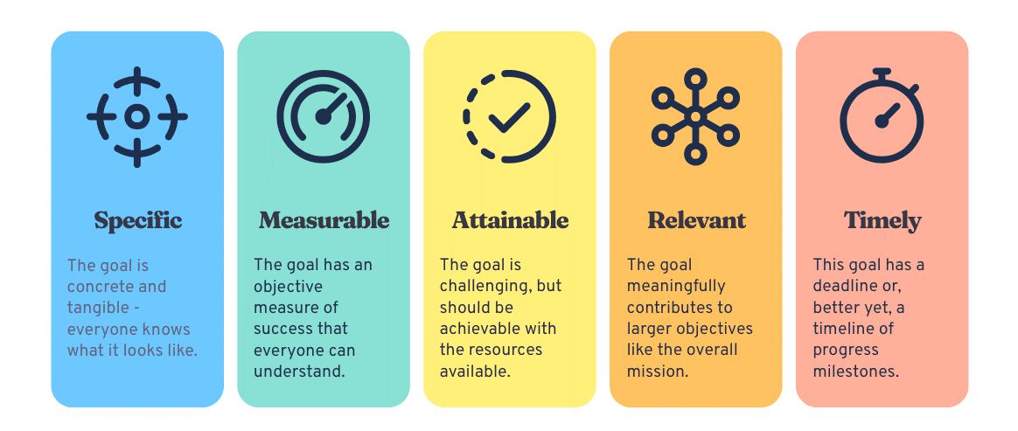
SMART KPIs
KPIs are best to be tailored to align with the company’s strategic objectives and operational goals.
They should be Specific, Measurable, Achievable, Relevant, and Time-bound.

Slide 85

Example
An entrepreneur is working within a complex unwelcoming market. She decides to set a SMART realistic objective: To increase brand visibility by 30% in 6 months through targeted social media marketing and partnerships with community organizations
Specific: Focus on brand visibility through social media and partnerships.
Measurable: Track metrics like follower growth and engagement.
Achievable: Realistic with available platforms and community support.
Relevant: Ensure easy market presence.
Time-bound: Set to be achieved in 6 months.

Slide 86
Benchmarking for Performance Improvement
Benchmarking involves comparing your performance metrics with best-in-class companies or industry averages to identify gaps and areas for improvement.
It helps identify performance gaps and inefficiencies and encourages innovation by learning from industry leaders. Benchmarking serves as an intermediate tools between setting SMART goals and developing continuous improvement strategy.
Internal Benchmarking: Comparing performance across different departments or teams within the company.
Competitive Benchmarking: Measuring your business performance against direct competitors.
Industry Benchmarking: Comparing your performance against general industry standards.

Slide 87
Continuous Improvement Methodologies
Total Quality Management (TQM): A holistic approach focused on long-term success through stakeholder satisfaction, involving the team in the process.
Kaizen: A Japanese concept meaning “change for the better,” Kaizen encourages small, ongoing changes to improve productivity and efficiency.
Kaizen Events: Short-term focused improvement initiatives that address specific problems and improve operational performance.
Key principles for these methodologies require:
Employee Involvement: Everyone in the organization contributes to continuous improvement.
Small, Incremental Changes: Focusing on regular, small improvements leads to significant long-term benefits.

Slide 88
Tool: Performance Dashboard
Expanding Your Network
Performance Dashboards provide a real-time overview of key performance metrics, enabling businesses to track and respond to changes quickly. Dashboard Features provide:
Visual Representation: Graphs, charts, and data visualizations to monitor KPIs at a glance.
Customization: Tailor dashboards to display most critical metrics for different teams or functions.
Alerts: Set up automated alerts for when KPIs fall outside acceptable ranges.
Key Benefits of Dashboards:
Quick Decision-Making: Instant access to performance data.
Accountability: Easy to identify which areas are meeting or missing targets.
Online Tools available for Designing KPI Dashboards (with Freemium Options): ClickUp, Klipfolio, Smartsheet, Databox, Datapad, but could be custom-made with Excel and Google Sheets.

Slide 89
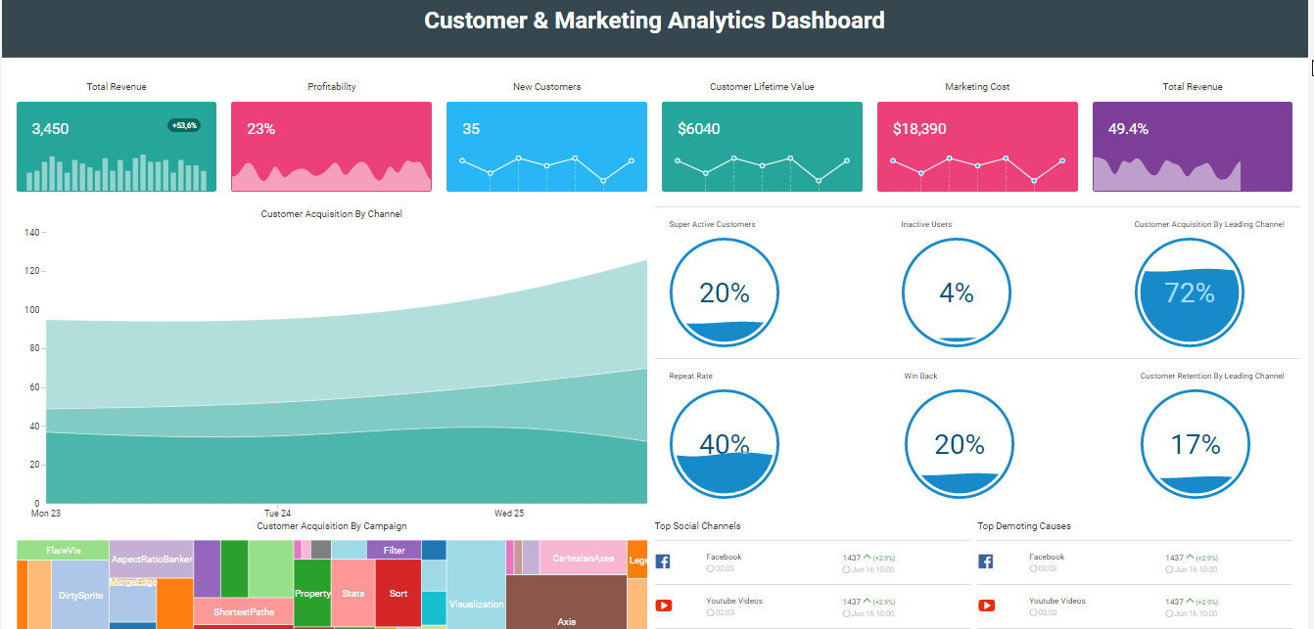
Example: Performance Dashboard Tools
Expanding Your Network

Slide 90

Be inspired by..
This video is a step-by-step guide to building important KPI dashboards for free.
The video’s key learning are:
What is a KPI Dashboard?
Why Use a KPI Dashboard?
Setting Up the Dashboard with Google Data Studio
Creating the Dashboard with customised templates
Track relevant KPIs and avoid vanity metrics.
External Link

Slide 91

Activity : Dashboards, Learning by Doing
Expanding Your Network
Participants assume various functions within a startup. They will discuss together to decide how to:
  Step 1: Identify key business objectives, align KPIs with these goals.
  Step 2: Collect data for each KPI using relevant tools (e.g., CRM, financial software, production systems).
  Step 3: Set performance targets and track progress.
  Step 4: Regularly review and adjust KPIs based on evolving business needs or external factors.
Key Points of Action:
  Make sure KPIs are actionable and can be directly influenced by your operations.
  Regular reviews ensure that KPIs remain relevant as your business grows or market conditions change

Slide 92
Fostering a Continuous Improvement Culture
Continuous improvement is not a one-time initiative; it must be built into the team’s culture and should be recognised and celebrated.
Leadership Buy-In
Employee Engagement:
Training and Development
Top-level management should support and model continuous improvement behavior
Provide ongoing training on continuous improvement tools and techniques (e.g., Lean, Six Sigma, Kaizen)
Involve employees at every level to encourage participation and ownership of improvements

Slide 93

Example
A small restaurant was struggling with long customer wait times and frequent ingredient shortages.
Kaizen Event: Over a 3-day period, the restaurant’s team analyzed the workflow and identified inefficiencies in how orders were taken and ingredients were restocked.
Outcome: By reorganizing the workspace, improving order tracking, and negotiating better delivery terms with suppliers, the bakery reduced wait times by 25% and eliminated stockouts.

Slide 94

Key Takeaways
Quality Requires Frameworks
1
Performance Indicators & benchmarking are essential tools for measuring operational success and should be predefined
Sustained Improvement is a Continuous Process
2
Continuous improvement methodologies like TQM, Kaizen, and Lean are vital for sustained operational efficiency
Quality = Team Culture
3
Advanced techniques that involve all stakeholders drive deeper improvements in performance and quality

Slide 95
“Measure What Matters: The Simple Idea that Drives 10x Growth" by John Doerr -
A resource for understanding how to set and track KPIs through Objectives and Key Results (OKRs), with cases of successful companies.
"Kaizen: The Key to Japan's Competitive Success" by Masaaki Imai - A foundation on the Japanese philosophy of continuous improvement. It provides insights on how incremental changes can lead to significant improvements in productivity & quality.
"The Balanced Scorecard: Translating Strategy into Action" by Robert K & David N -This book introduces the Balanced Scorecard framework, a widely used tool for measuring organizational performance.
Further Reading

Slide 96
05
Self Reflection and References

Slide 97
Final Word – Ethical Operations Management
Ethical Sourcing
Community Empowerment
Environmental Responsibility
Transparency & Advocacy
Prioritise materials and services from minority-owned or socially responsible suppliers
Create products that celebrate cultural heritage or meet authentic needs
Use eco-friendly methods to build credibility with conscious stakeholders
Publicly share ethical practices and advocate for inclusivity & diversity

Slide 98
Underrepresented Resilience & Operations (1)
Resource Constraints and Innovation:
Underrepresented entrepreneurs often face limited access to capital, but these constraints can foster innovation. Encourage frugal innovation, where limited resources drive creative solutions e.g. using free tools or re-purposing materials.
Community Support and Networking:
Leverage community networks (e.g., local business groups, cooperative funding, or shared workspace initiatives) to access affordable resources, advice, and mentorship.
Bootstrap Operations:
Focus on bootstrapping strategies, where profits are reinvested to grow the business gradually. This minimises dependence on traditional funding sources and allows for steady, organic growth.

Slide 99
Underrepresented Resilience & Operations (2)
Flexible Staffing Solutions:
Consider alternative staffing models, such as freelancers, part-time workers, or internship programs, to manage labor costs while ensuring operational flexibility.
Limited Access to Capital:
Highlight the challenge of accessing traditional funding streams due to systemic biases. Recommend alternative financing options like community lending, crowdfunding, or microfinance. See our MOSAIC finance models.
Bias in Supply Chain and Partner Networks:
Discuss difficulties of securing reliable suppliers & partners who may undervalue underrepresented businesses. Recommend supplier diversity approaches.

Slide 100
Underrepresented Resilience & Operations (3)
Navigating Market Entry Barriers:
Many under-represented entrepreneurs face difficulties entering mainstream markets. Encourage participation in business incubators and industry associations that provide mentorship and connections to broader market opportunities.
Building Operational Resilience:
Emphasise creating adaptive business models that are resilient in the face of market shifts and focus on diversifying revenue streams or pivoting offerings to meet changing market demands.

Slide 101
General Do’s
General Do’s and Don’ts
DO Prioritise Resource Optimization: Regularly assess your resource needs and ensure alignment with your business goals.
DO Leverage Technology: Use affordable tech solutions to automate repetitive tasks and improve efficiency.
DO Apply Lean Principles for Continuous Improvement: Seek ways to eliminate waste and streamline operations.
DO Monitor Financial Health: Regularly update budgets and forecasts to stay on top of cash flow and costs.
DO Foster Supplier Relationships: Build long-term partnerships with reliable suppliers to ensure consistency and scalability.

Slide 102
General Don’ts
General Do’s and Don’ts
DON’T Ignore Operational Inefficiencies: Failing to address inefficiencies can lead to higher costs and delays.
DON’T Neglect Financial Planning: Poor budgeting and cash flow management can cause business failure even in profitable companies.
DON’T Avoid Technology: Hesitating to adopt automation will limit your capacity to scale.
DON’T Overlook Employee Potential: Underutilised talent leads to decreased productivity.
DON’T Stop Improving: ContinuousiImprovement of your quality is essential for long term growth especially for under-represented entrepreneurs.

Slide 103

Global Case Study : Food Truck Project, by SINGA
On this link, you can find a brief booklet guide, which takes the example of a food-truck business considering all the steps that could apply to any business idea, in any European country.
The booklet considers the essential steps to build an operational model before launching a business.
It is available and commented in English, French, and Arabic.
Notes:
https://sites.google.com/singa.io/singas-knowledge-base/accueil/communaut%C3%A9

Slide 104
Self Assessment Quiz
We offer you a short questionnaire for self-assessment of the extent to which you have understood the content.
The goal is to check and reinforce what you have learned.
You can take the quiz as many times as you want. Remember, the quiz is just part of the process of learning new things!

Slide 105
Reflection and Quiz (1)
Think about your current or planned operations and resource management practices. How effectively are you allocating resources across different business functions?
What are the biggest operational inefficiencies in your business?
Are your resource management practices contributing to business growth, or hindering it?
How could you optimise your operations to reduce waste and improve output?
What specific areas could benefit from the application of lean principles?
Action Step: Identify one area of your operations that needs immediate improvement and develop an action plan for resource reallocation.

Slide 106
Reflection and Quiz (2)
Reflect on the current state of your supply chain. Are there areas where you could implement better management practices to improve efficiency?
Reflection Questions:
How strong are your relationships with suppliers?
Are you experiencing bottlenecks in logistics or inventory management?
How are you mitigating risks in your supply chain?
Do you have a system in place to monitor supplier performance?
How could you reduce costs without sacrificing quality in your supply chain?
Action Step: Evaluate your vendor scorecards or create one to improve how you track supplier performance.

Slide 107
Reflection and Quiz (3)
Reflect on your readiness to scale. Consider whether your current operations can handle increased demand without sacrificing quality or efficiency.
Reflection Questions:
Are your processes standardised and documented to support scalability?
How are you using technology to automate operations and prepare for growth?
Did you prepare the needed financial operations to scale?
How will your supply chain adapt to increased demand?
What steps can you take to ensure a smooth transition as your business scales?
Action Step: Identify one area of your operations that can be automated or improved to prepare for growth.

Slide 108
Reflection and Quiz (4)
Reflect on current or planned quality control & performance measurement practices.
Reflection Questions:
What quality control tools or techniques are you using to monitor performance?
How often do you review your quality management systems and your performance to ensure they meet industry standards and KPIs?
How effectively are you benchmarking to compare your business with competitors?
What continuous improvement methodologies (e.g., TQM, Kaizen) have you implemented, and how successful have they been?
Action Step: Identify specific areas of your operations where you can improve either quality control or performance measurement, then develop an adapted action plan.

Slide 109

CONGRATULATIONS
You have now completed our MOSAIC course to support under-represented entrepreneurs. Please stay connected to us by joining our social media channels and visit our website for many more resources to assist your ambitions.
www.mosaic4investing.eu

